Slide 1
Tests hépatiques perturbés Cas clinique
Hôpital de Delémont, 30 novembre 2023
PD Dre Montserrat Fraga
Service de Gastroentérologie et d’Hépatologie

Slide 2
Cas clinique
47 ans
Obésité de classe I (BMI à 31 kg/m2)
Pas de consommation de drogues ni d’alcool
Pas de traitements, pas de phytothérapie

Slide 3
Cas clinique
Adressé aux urgences: douleurs de l’HCD, état fébrile à 38.5°C depuis 3 jours
Discrète perturbation du bilan hépatique ALAT 156 U/I, ASAT 143 U/I; PAL 89 U/I; GGT106 U/I
TP, bilirubine totale et albumine dans la norme
Examen clinique : EF à 38.5°C. Stable HD. Vésicules du tronc et du visage (nouvelles selon patient). Douleurs de l’HD sans Murphy.

Slide 4
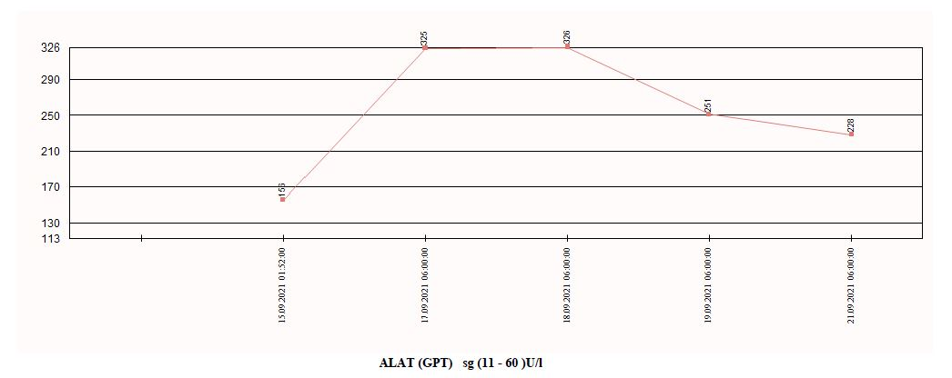
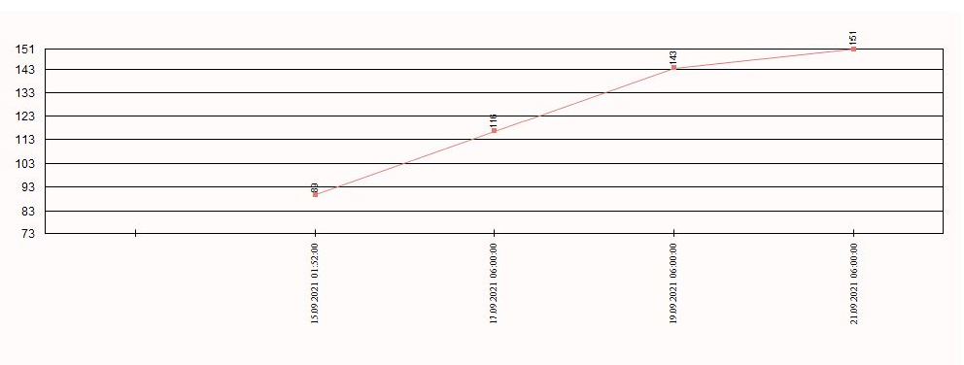
Cas clinique
ALAT U/l
PAL U/l

Slide 5
Cas clinique
Quelle investigations initiales?
A) Bilan sanguin complémentaire
B) US abdominal
C) US abdominal + FibroScan®
D) Consultation spécialisée de l’obésité
E) Suivi biologique en ambulatoire: l’ALAT est modérément élevée!

Slide 6
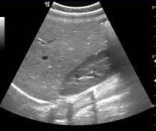
Hépatomégalie stéatosique sans dysmorphie
Quelques ganglions lymphatiques hypertrophiés au niveau de l'hile
Pas de dilatation des voies biliaires.
Vx perméables

Slide 7
Cas clinique
Sérologies: IgM HAV (-), HBsAg et HBV DNA (-), anti-HCV (-),CMV (IgM -, IgG +), EBV (IgM -, IgG +), PCR HEV(-)
HIV négatif.
RT-PCR SARS-Cov-2 négatif
Bilan auto-immun: FAN 1/80, IgG totales normales, reste du bilan neg.

Slide 8
Approche pratique face à des tests hépatiques perturbés
Définitions
Diagnostic différentiel
Bilan

Slide 9
Definitions
Hepatocellular integrity AST, ALT
Cholestasis AP, γ-GT
Synthetic and excretory function PT, albumin, bilirubin
Acute hepatitis vs chronic hepatitis
< 6 months > 6 months

Slide 10
Diagnotic tools
Anamnesis and clinical exam
Radiology (US, Elastometry, CholangioMRI)
Laboratory
Liver biopsy

Slide 11
Chronic Liver Function Test Elevation
Liver Biopsy
Percutaneous, transjugular, EUS guided
Definitive diagnosis
Grading and staging
Expert pathologist crucial!

Slide 12
Differential diagnosis
Alcohol
DILI
NAFLD
Auto-immune liver diseases
Viral hepatitis
Rare hereditary liver diseases
Vascular liver diseases
….

Slide 13
LFT’s in Alcoholic Liver Disease
EASL Clinical Practice Guidelines: Management of alcohol-related liver disease. J Hepatol 2018

Slide 14
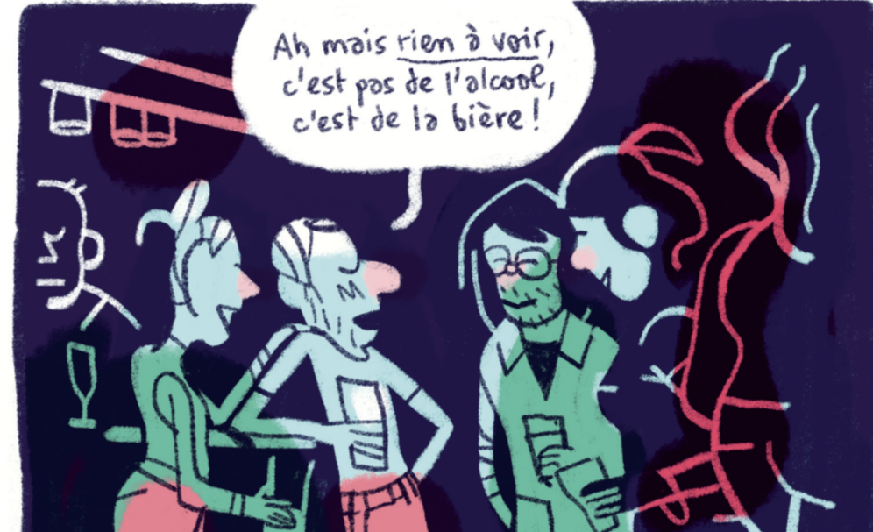

Slide 15
Indirect and direct alcohol markers
CDT: Daily intake of 50–80 g of ethanol over a period of at least one to two weeks is required for a positive CDT. Many confounding factors for the measurement of CDT, notably cirrhosis.
Ethylglucuronide (EtG; urine: 80 hours; hair: up to 3 months)
PEth (phosphatidyléthanol): dried blood, up to 3 weeks
EASL Clinical Practice Guidelines: Management of alcohol-related liver disease. J Hepatol 2018

Slide 16
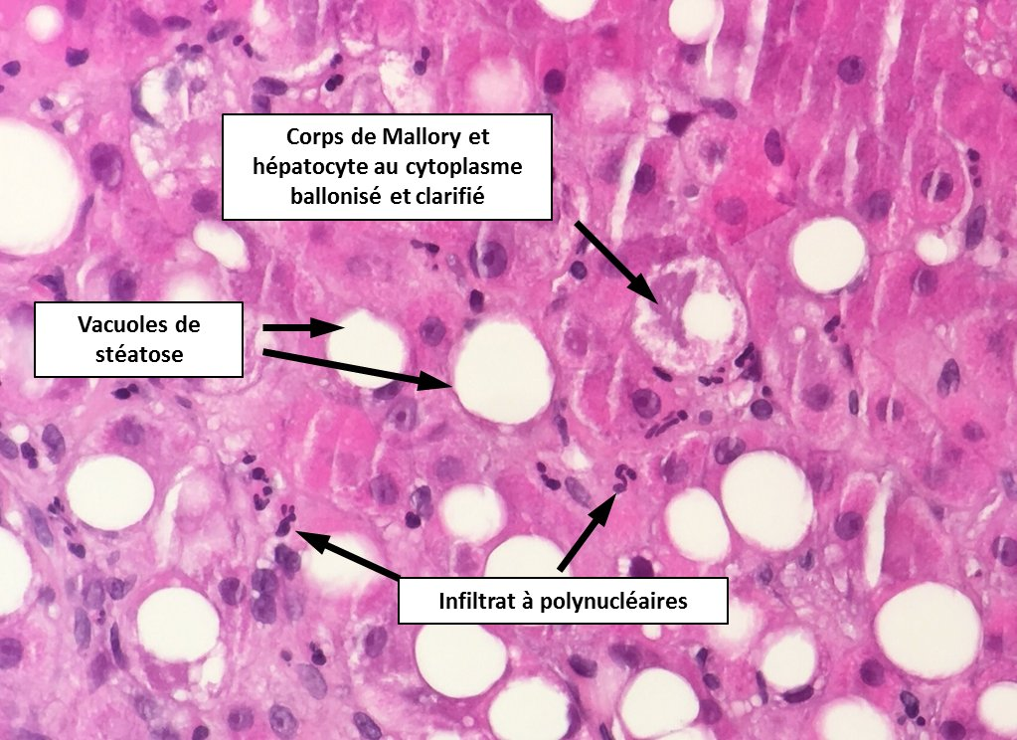
Alcoholic hepatitis
"A distinct clinical syndrome characterized by the recent onset of jaundice with or without other signs of liver decompensation in patients with ongoing alcohol abuse "
EASL Clinical Practice Guidelines: Management of alcohol-related liver disease. J Hepatol 2018

Slide 17
Drug Induced Liver Injury
Pattern of liver injury: hepatocellular, cholestatic or mixed
In general full recovery. Rare cases of ALF
The proportion of patients in whom DILI was caused by herbal and dietary supplements has been increasing
Statins< 1/50 000!
Andrade RJ et al. Nat Rev Dis Primers 2019.

Slide 18
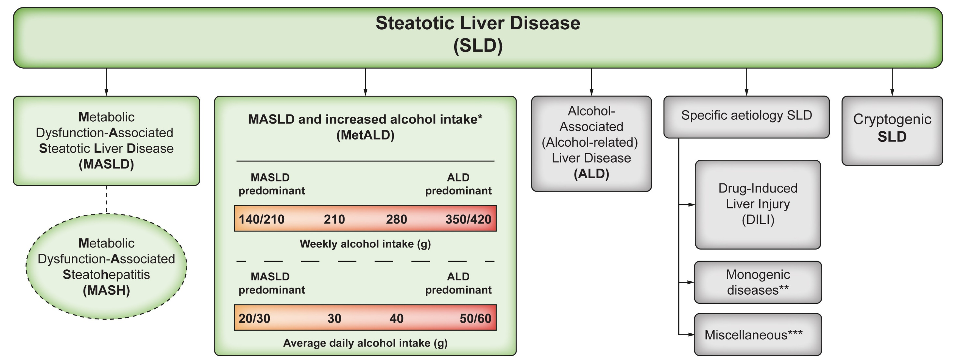
Rinella ME, et al. Hepatology 2023.

Slide 19
Younossi ZM et al., Hepatology 2016; Younossi ZM et al., Hepatology 2019

Slide 20
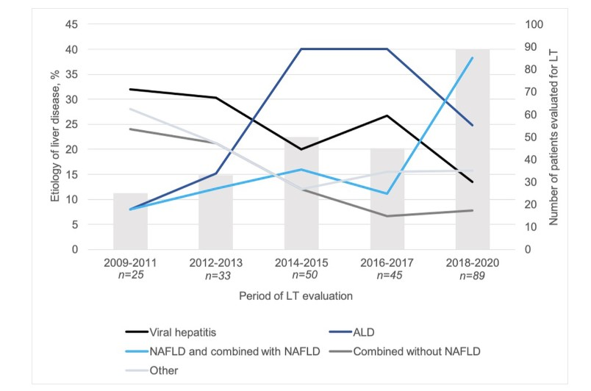
Kasmi S, et al. Swiss Med Wkly 2022.

Slide 21
MAFLD diagnosis
Mildly elevated serum aminotransferases (AST:ALT < 1), AP and/or g-GT, ferritin
Exclude significant alcohol consumption
Exclude other chronic liver disease
Associated metabolic conditions
Ultrasound
Liver biopsy

Slide 22
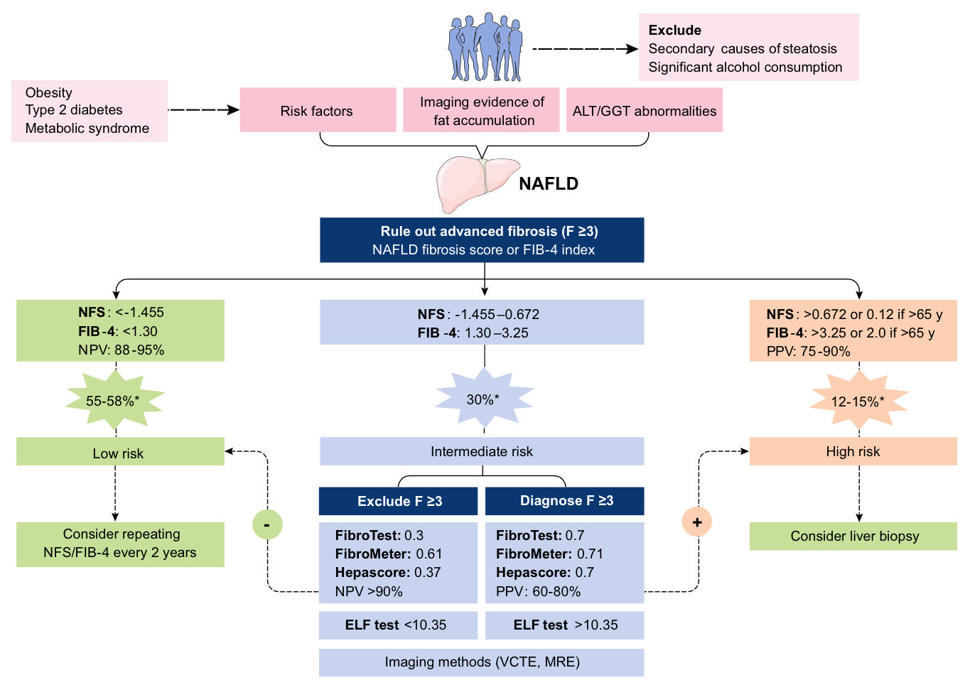
MAFLD: noninvasive assessment
NFS score base sur âge, glycémie, BMI, plaquettes, albumine, et ratio AST/ALT
FIB-4 score basé sur âge, plaquettes et ratio AST/ALT ratio
VCTE (Fibroscan) < 8 kPa
VCTE (Fibroscan) > 8 kPa
Vilar-Gomez E et al., J. Hepatol 2018.

Slide 23
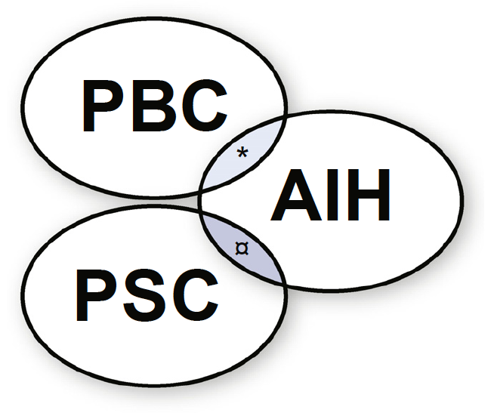
Autoimmune liver diseases
Autoimmune hepatitis
Primary biliary cholangitis
Primary sclerosing cholangitis
Overlap syndromes
IgG4-associated cholangitis
Boberg KM et al. on behalf of the IAIHG. J Hepatol 2011
EASL Clinical Practice Guidelines: Autoimmune hepatitis. J Hepatol 2015
EASL Clinical Practice Guidelines: The diagnosis and management of patients with PBC. J Hepatol 2017

Slide 24
Autoimmune hepatitis
Prevalence 15-25/100'000
: = 3 : 1
Different clinical presentation (asymptomatic – ALF- chronic hepatitis – cirrhosis)
Frequently associated to other autoimmune diseases
AASLD Practice Guideline - Manns MP et al. Hepatology 2010;51:2193-2213.
EASL Clinical Practice Guideline. J Hepatol 2015;63:971-1004.
Notes:
- Spontaneous disease fluctuations
- 1/3 cirrhotic at initial presentation
- Second most common cause of "cryptogenic cirrhosis" (after NASH)
- Familial predisposition (HLA DR3 and DR4 in AIH type I)
- Associated conditions: thyroiditis (10-20%), IBD, RA, psoriasis, Sjögren, CD, SLE, ...

Slide 25
Autoimmune Hepatitis
Diagnosis
Exclusion of other liver diseases
Autoantibodies
Gamma-globulins (IgG) ↑
Liver biopsy
Response to treatment
ANA, SMA (anti-actin)
anti-LKM1
Others: SLA/LP, anti-LC1
Type 1
Type 2

Slide 26
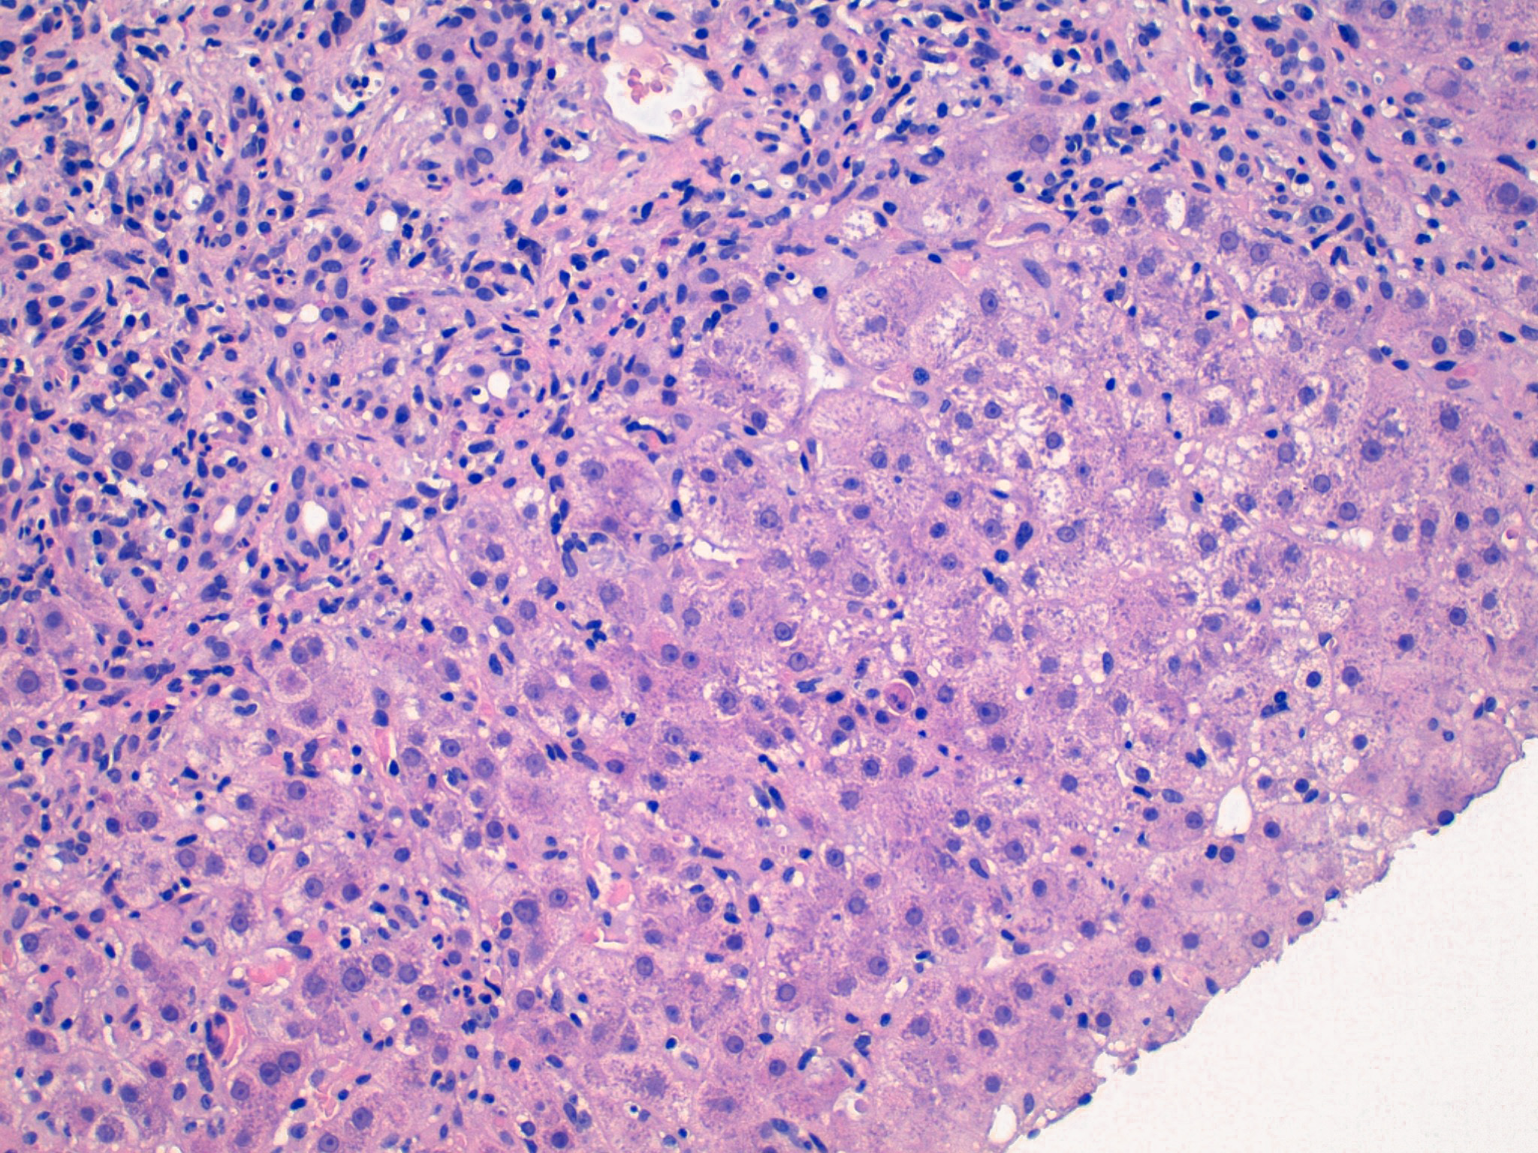
Courtesy of Christine Sempoux

Slide 27
Autoimmune Hepatitis
Simplified Diagnostic Criteria
Points
Autoantibodies ANA or SMA ≥ 1:40 1
ANA or SMA ≥ 1:80
or LKM ≥ 1:40 2
or SLA/LP pos. (any titer)
IgG (or γ-globulins) > ULN 1
> 1.1 x ULN 2
Liver histology Compatible with AIH 1
Typical of AIH 2
Absence of viral hep. Yes 2
6 points → probable AIH (sens. 88%, spec. 97%) | ≥ 7 points → definite AIH (sens. 81%, spec. 99%)
Hennes EM et al. and the IAIHG. Hepatology 2008;48:169-176.

Slide 28
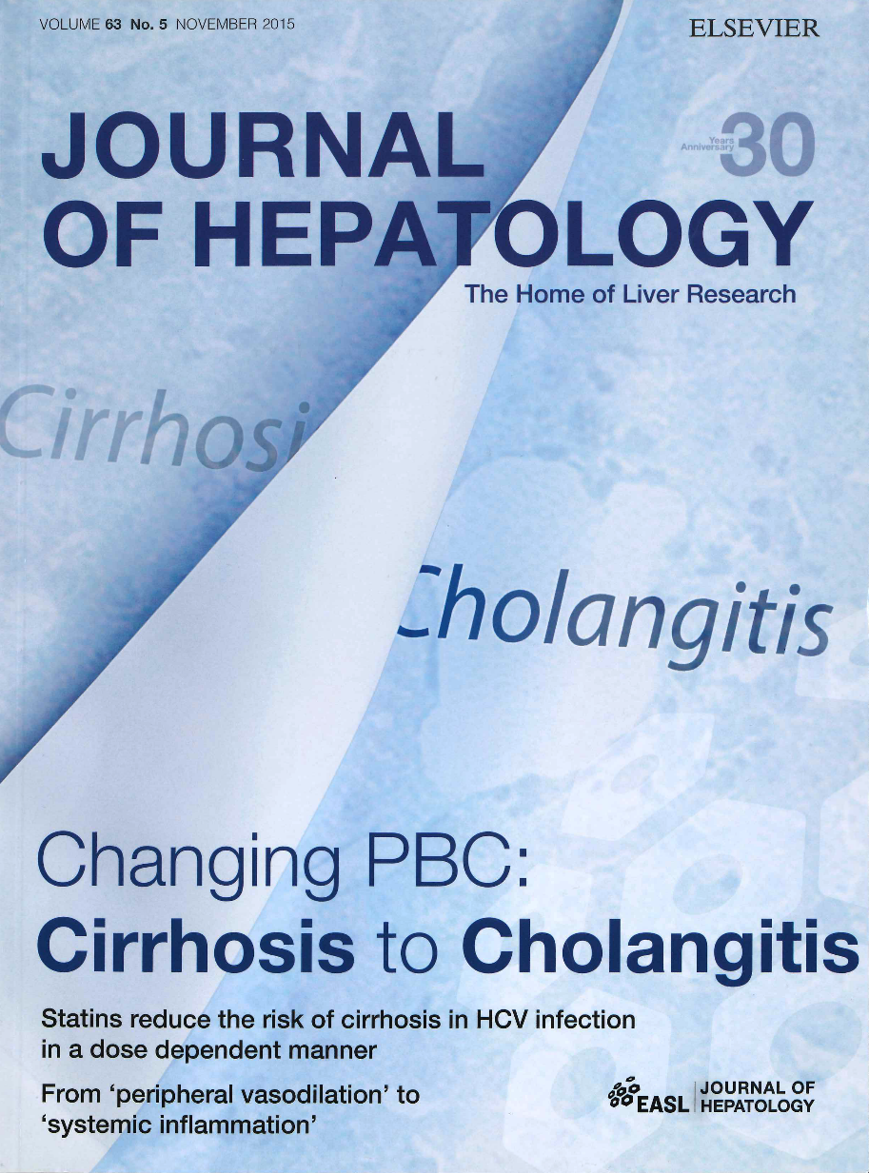
Primary Biliary Cholangitis
Primary biliary cirrhosis
Autoimmune disease with progressive destruction of small bile ducts
Prevalence 2-40/100'000
♂ : ♀ = 1: 9, peak age 40-60 years
May be associated with other auto-immune diseases (Sjögren's syndrome, thyroiditis, celiac disease, RA, ...)
Beuers U et al. J Hepatol 2015;63:1285-1287.
EASL Clinical Practice Guideline. J Hepatol 2017;67:145-172.
Lindor K et al. AASLD Practice Guidance. Hepatology 2019;69:394-419.

Slide 29
Primary Biliary Cholangitis
Diagnosis
Initially asymptomatic alkaline phosphatase ↑, g-GT ↑
Antimitochondrial antibodies (AMA) (anti-M2 = E2 subunit of pyruvate dehydrogenase complex)Sensitivity and specificity > 95%
IgM ↑
Liver biopsy (not mandatory)

Slide 30
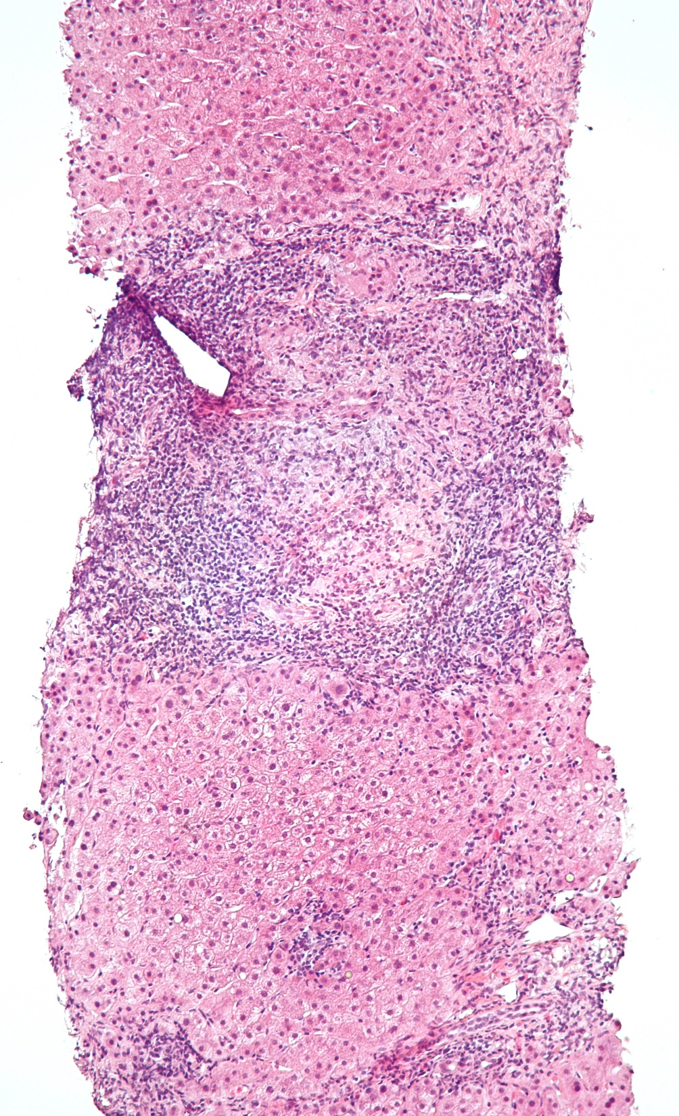
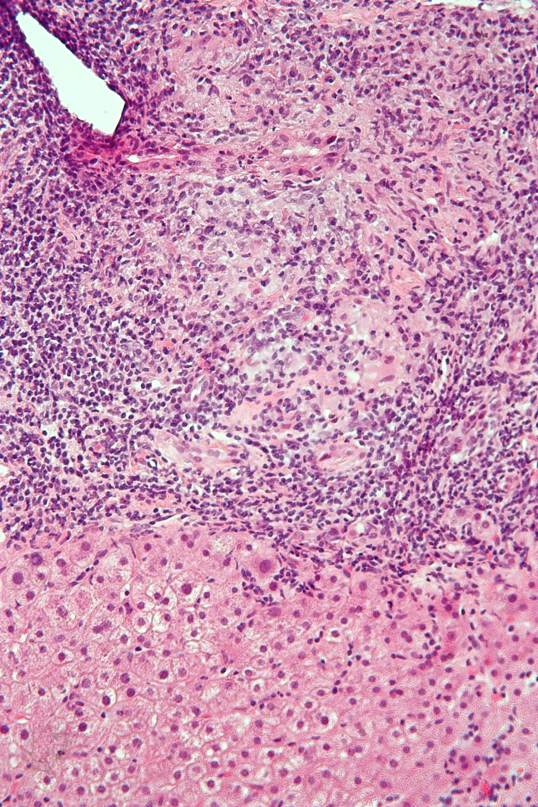
Notes:
Florid duct lesion = focal duct obliteration with granuloma formation

Slide 31
Primary Sclerosing Cholangitis
Chronic fibrosing inflammatory process of medium- and/or large-size, intra- and/or extrahepatic bile ducts
Prevalence 5-10/100'000
♂: ♀ = 2 : 1, mean age 40 years
80-90% associated with IBD (UC > CD)
EASL Clinical Practice Guideline. J Hepatol 2009;51:237-267.
AASLD Practice Guideline - Chapman R et al. Hepatology 2010;51:660-678.
Karlsen TH and Boberg KM. J Hepatol 2013;59:571-581.
Lazaridis KN and LaRusso NF. N Engl J Med 2016;375:1161-1170.
ESGE-EASL Clinical Practice Guidelines. J Hepatol 2017;66:1265-1286.

Slide 32
Primary Sclerosing Cholangitis
Clinical Manifestations
Initially asymptomatic (AP ↑, g-GT ↑)
Pruritus, pain, fatigue, jaundice
Complications: - bacterial cholangitis - cholangiocarcinoma (1.5% per year!) - complications of chronic cholestasis - complications of cirrhosis - colorectal cancer

Slide 33
Primary Sclerosing Cholangitis
Diagnosis
Alkaline phosphatase ↑, g-GT ↑
MRCP
"Atypical" pANCA pos. in 50-80% but not sufficiently specific
Evtl. ERCP (antibiotic prophylaxis!)
Evtl. liver biopsy (staging)
Colonoscopy

Slide 34
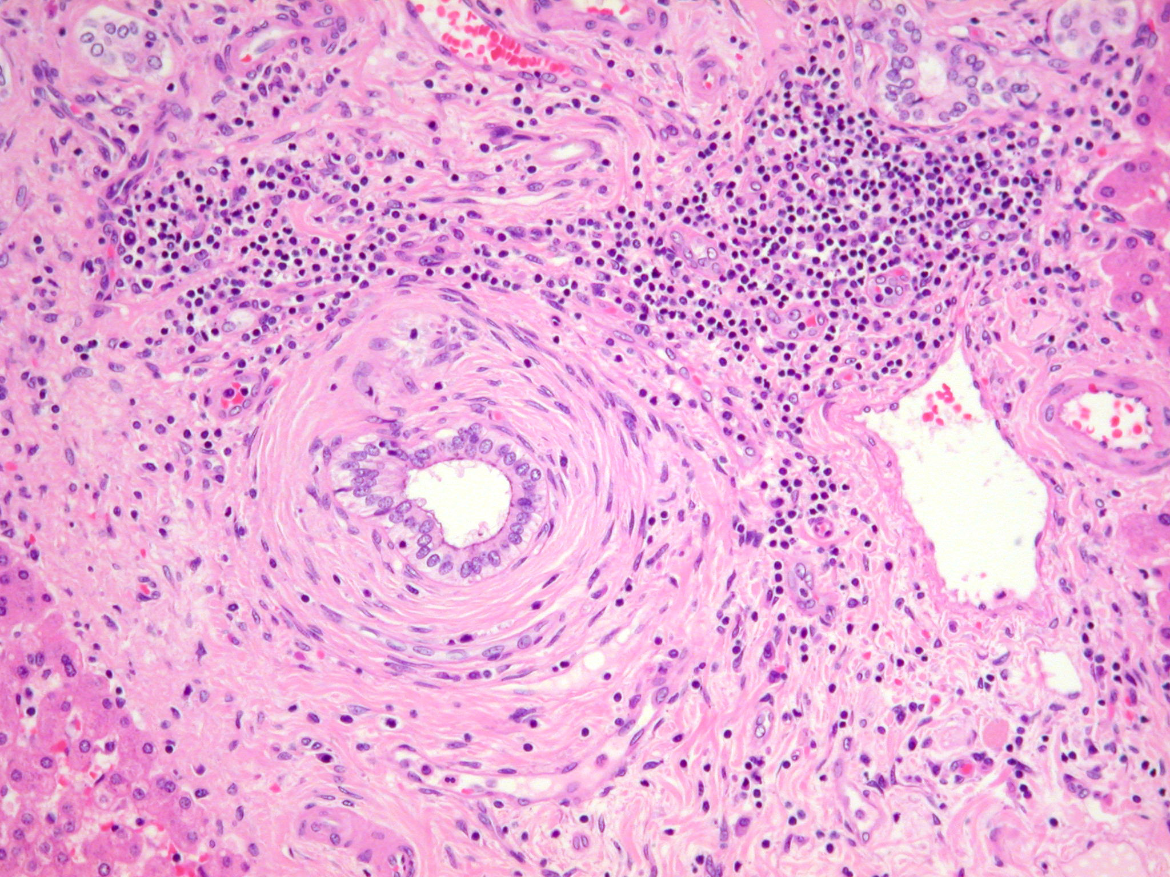
Courtesy of Laura Rubbia-Brandt
Notes:
Rondelles d'oignon

Slide 35
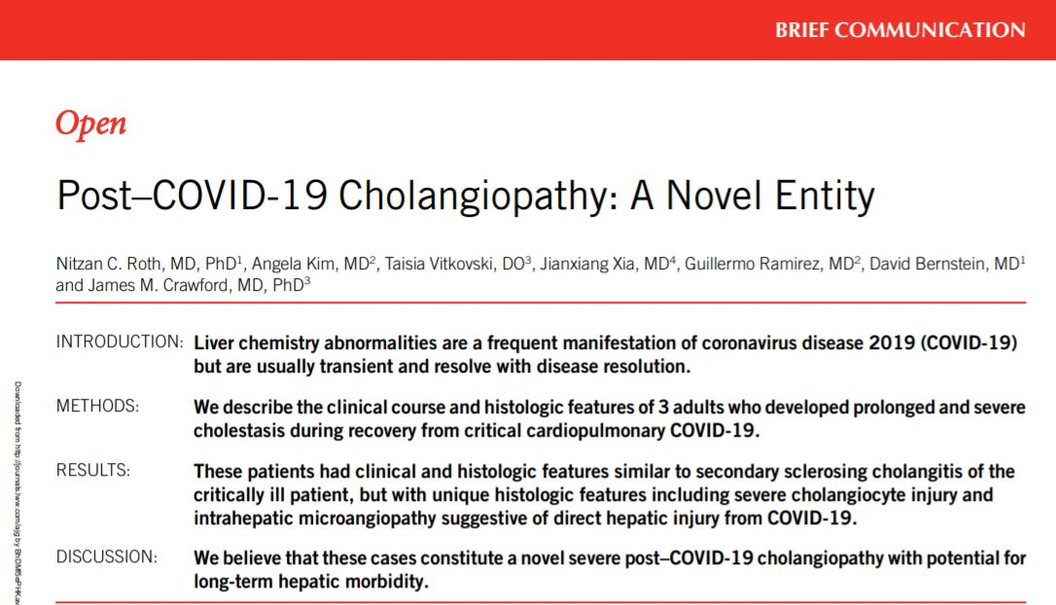

Slide 36
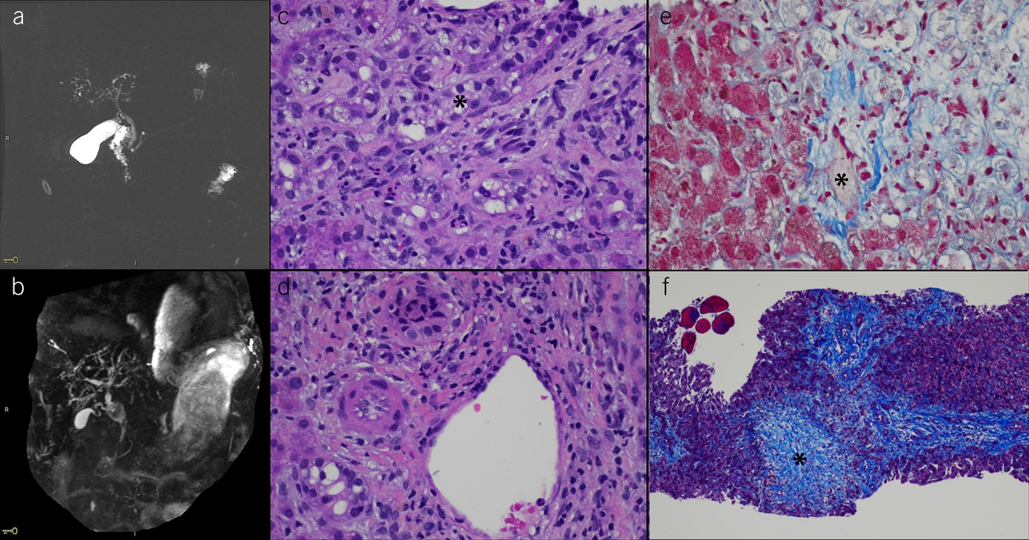
Notes:
Magnetic resonance cholangiography and histopathology. (a) Magnetic resonance cholangiogram of patient 1 (day 158) with marked irregularity of the intrahepatic biliary tree with attenuation and intervening areas of beading and mild irregularity of the extrahepatic bile duct, measuring up to 5 mm with normal distal tapering but with periductal enhancement. (b) Magnetic resonance cholangiogram of patient 2 (day 88) with dilatation of the central intrahepatic and extrahepatic biliary tree, with common bile duct measuring up to 12 mm at the level of the porta hepatis and 11 mm just above the ampulla. (c) Portal tract in the biopsy of patient 2. Profound cholangiopathy with cholangiocyte cytoplasmic vacuolization is shown, including an interlobular bile duct in longitudinal section (*); the ductular reaction in this field also shows severe cholangiocyte swelling. (d) Portal tract in the biopsy of patient 2. The hepatic artery (middle left) shows microarteriopathy with endothelial swelling and obliteration of the lumen. Also shown, an interlobular bile duct (top) with cholangiocyte degenerative changes and intraluminal cellular debris, and a bile ductule at the portal:parenchymal interface (lower left) with cholangiocyte cytoplasmic vacuolization. (e) Central region in the biopsy of patient 2. Trichrome stain highlights obliteration of a terminal hepatic vein indicative of focal sinusoidal obstruction syndrome (veno-occlusive disease; *); the adjacent zone 3 parenchyma is necrotic (upper right). (f) Low power trichrome stain of the biopsy of patient 1, showing portal-portal bridging fibrosis (right half of image) and fibrous obliteration of the zone 3 region and terminal hepatic vein (*). Five fragments of incidental skeletal muscle are present (upper left) (c, hematoxylin and eosin (H&E), 400×; d, H&E, 400×; e, trichrome, 400×; f, trichrome, 100×).

Slide 37
Viral Hepatitis
Host factors: immunocompetent vs immunosuppressed; chronic liver disease;...
HBsAg, anti-HBc, anti-HBs (and anti-HAV); anti-HCV; (and IgG/M anti-HEV and HEV PCR), IgM and IgG anti HEV+ HEV PCR
Follow-up: HBeAg, anti-HBe, HBV DNA, anti-HDV; HCV RNA, HCV genotype
Immunosuppressed individuals: Think broader! CMV , HSV,EBV,….

Slide 38
The Challenge of Hepatitis E
Most common cause of acute hepatitis and jaundice in the world
HEV gt 1 and 2 infect 20 mio people and claim 70,000 lives every year¹
HEV gt 3 and 4 represent a primarily porcine zoonosis (seroprevalence rates up to 86%)²
HEV gt 3 may trigger ACLF, can persist in immuno-compromised pts and cause neurologic complications
¹Rein DB et al. Hepatology 2012;55:988-97 | ²Mansuy JM, Gallian P et al. Hepatology 2016;63:1145-54. Reviewed in Hoofnagle JH et al. NEJM 2012;367:1237-44 and.Kamar N et al. Nat Rev Dis Primers 2017;3:17086. EASL CPG on HEV infection. J Hepatol 2018;68:1256-71.
Animation based on Yamashita T et al. PNAS 2009;106:12986-91 prepared by Noémi Oechslin and Jérôme Gouttenoire.

Slide 39
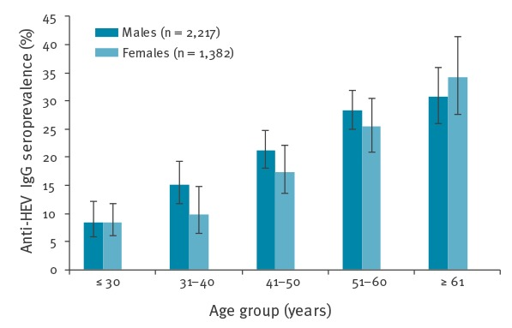
HEV: swiss blood donors
Niederhauser C, et al. Euro Surveill. 2018

Slide 40
Clinical Spectrum of Hepatitis E
Broad spectrum of liver disease severity: asymptomatic - mild hepatitis - liver failure¹
Extrahepatic manifestations^{2,3}
High fatality rate in pregnant women (gt 1)⁴ and patients with underlying liver disease
Autochthonous acute hepatitis E "hides" in drug-induced⁵ and other liver injuries
Chronic hepatitis and cirrhosis in immunocompromised patients⁶
¹Manka P et al. CGH 2015;13:1836-1842 | ²Dalton HR et al. Nat Rev Neurol 2016;12:77-85 | ³Pischke S et al. J Hepatol 2017;66:1082-1095 | ⁴Krain LJ et al. Am J Trop Med Hyg 2014;90:365 | ⁵Davern TJ et al. Gastroenterology 2011;141:1665-1672 | ⁶Kamar N et al. NEJM 2008;358:811-817.

Slide 41
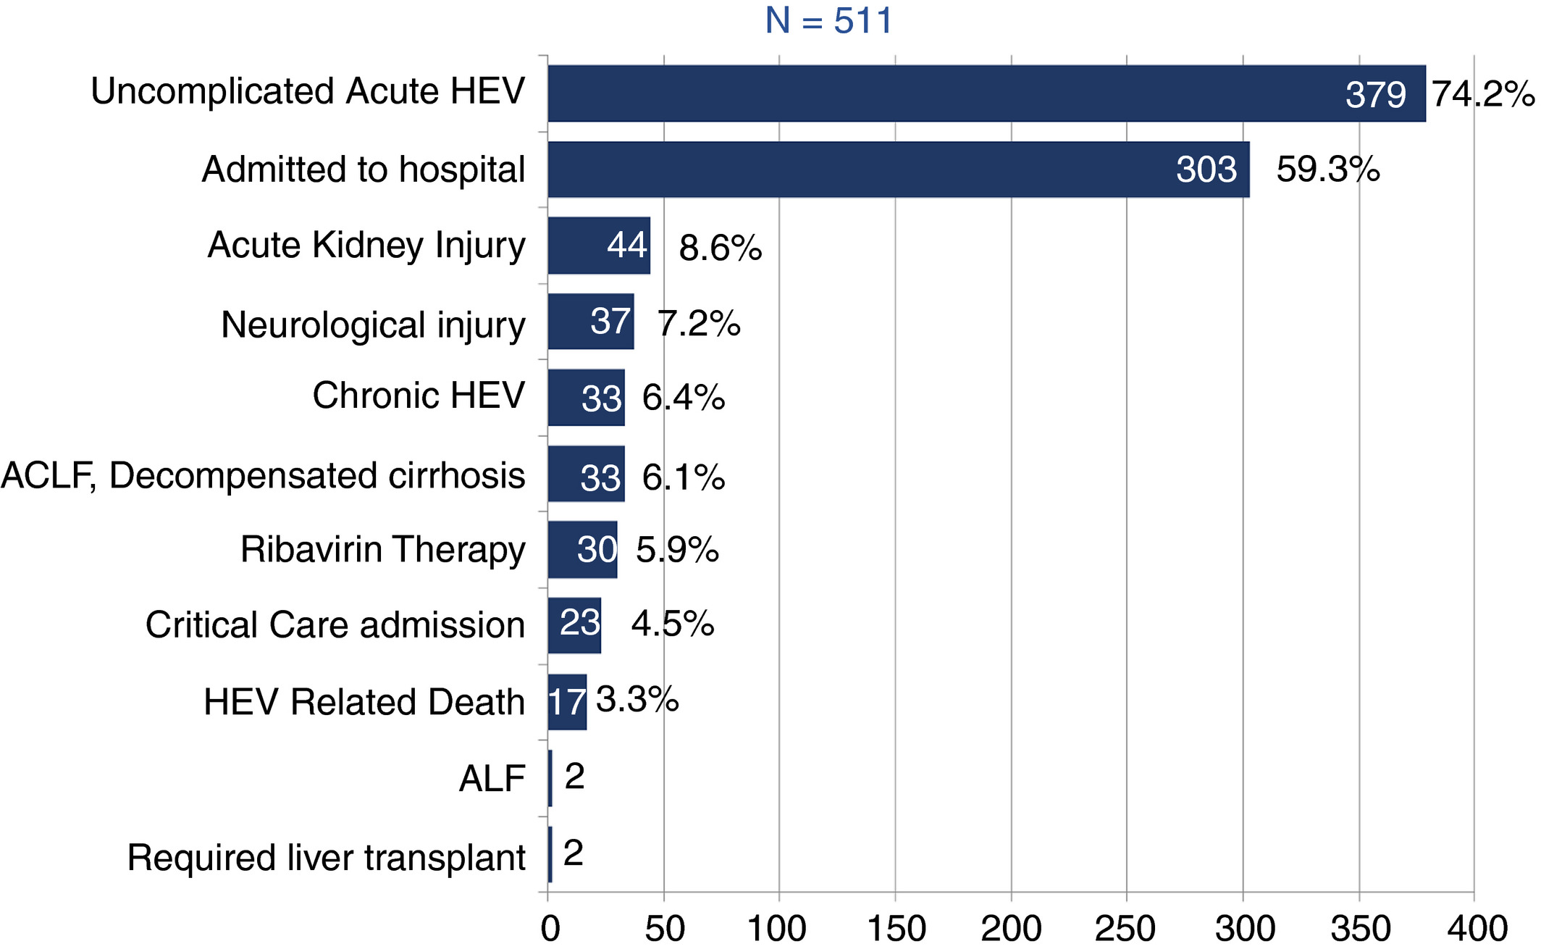
Morbidity and Mortality of Hepatitis E
Wallace SJ et al. Aliment Pharmacol Ther 2020;51:974-986.
Notes:
This retrospective Scottish study, highlights HEV important impact on morbidity and mortality.
Hematological malignancy, cirrhosis, higher serum bilirurin and chronic HEV infection predicted mortality
Among 58 cirrhotic patients, 33 developped ACLF. 2 patients required liver transplantation
3.3 %mortality, 4.5% patients required ICU admission

Slide 42
Hémochromatose héréditaire
Haemochromatosis is an AR disorder
Homozygosity for the p.Cys282Tyr (p.C282Y) variant in HFE is present in about 80% of individuals of European origin with the disease
Characterized by increased intestinal iron absorption and iron release from macrophages, leading to an expanded circulating iron pool, reflected by increased transferrin saturation.
This can lead to progressive body iron accumulation, that mainly manifests in the liver
EASL Clinical Practice Guidelines on haemochromatosis. J Hepatol 2022.

Slide 43
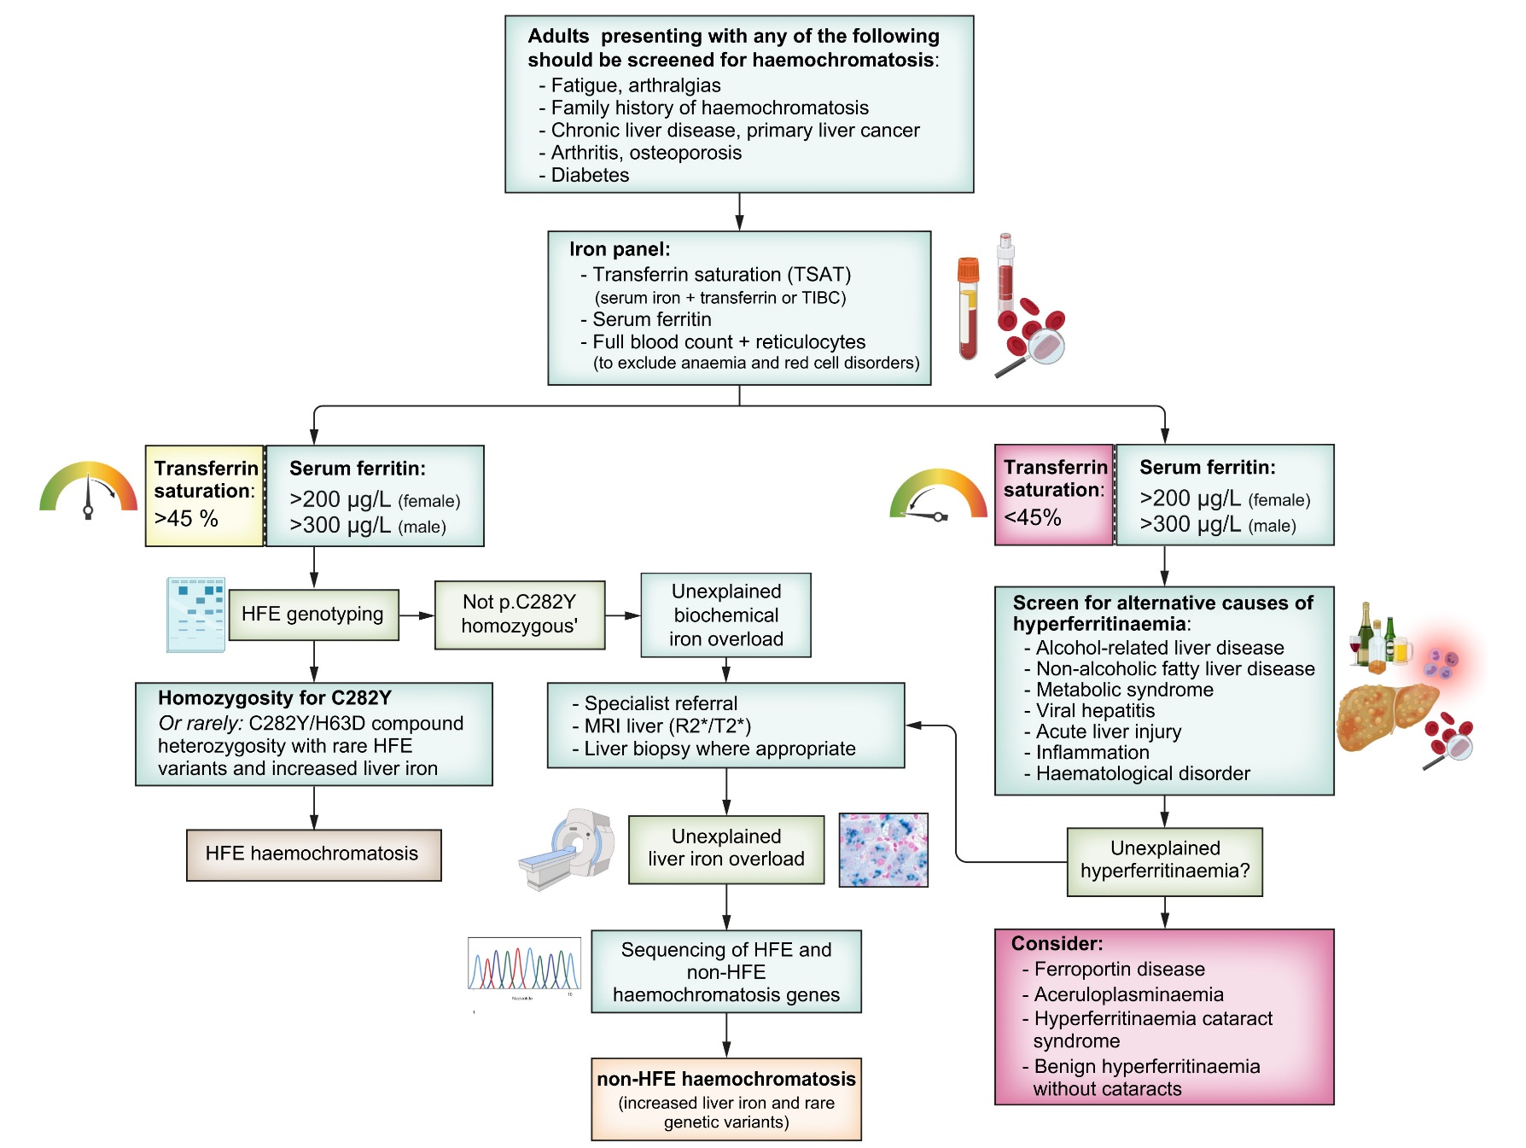
Hémochromatose héréditaire
EASL Clinical Practice Guidelines on haemochromatosis. J Hepatol 2022.

Slide 44
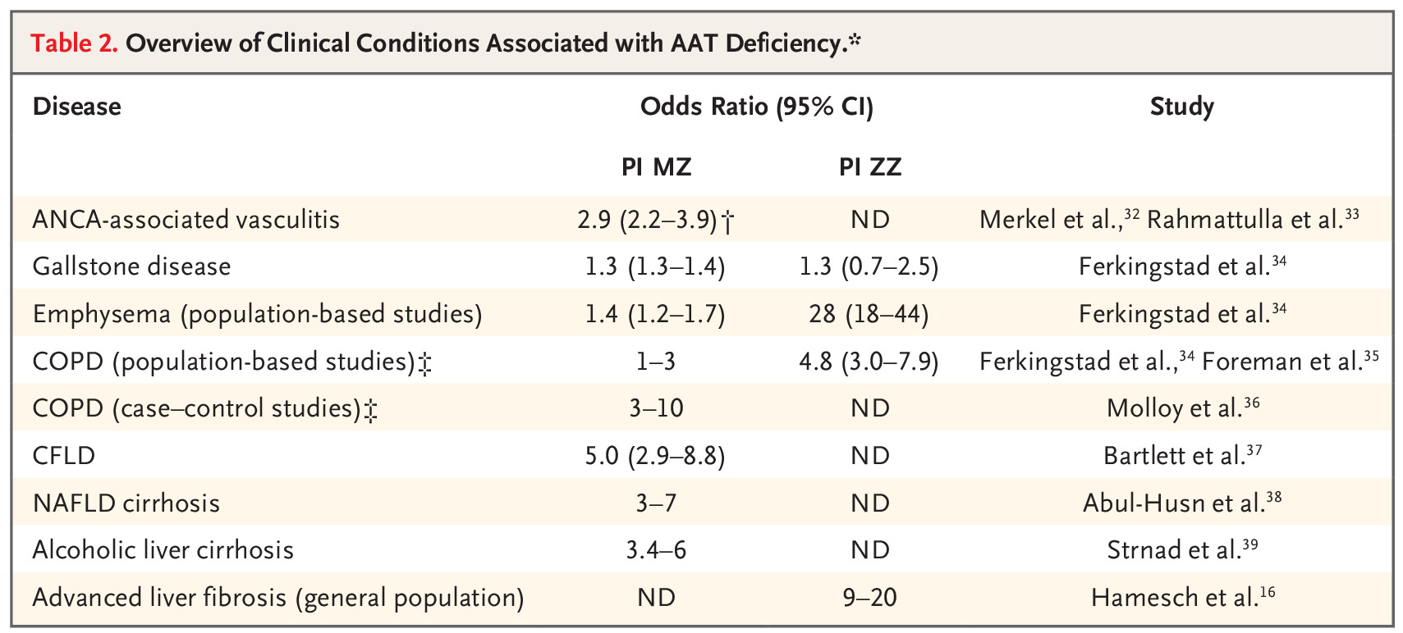
Alpha1-AT deficiency
Alpha₁-antitrypsin deficiency is an AR disorder and one of the most common genetic diseases
SERPINA1 gene mutation
Accumulation of toxic misfolded AAT within the liver
Strnad P et al., N Engl J Med 2020.

Slide 45
Wilson Disease: Pathophysiology
Prevalence ~ 1:30’000
Autosomal recessive disorder of copper metabolism
Mutations of ATP7B gene on chromosome 13* → impaired biliary copper excretion and accumulation → toxic injury to liver, brain and other organs
> 800 mutations described, most patients are compound heterozygotes
Roberts EA and Schilsky ML. Hepatology 2008.
EASL Clinical Practice Guidelines. J Hepatol 2012.
AASLD Clinical Practice Guidelines. Hepatology 2023.
Roberts EA, Schilsky ML. Current and. N Engl J Med 2023.
Notes:
Prevalence might be more elevated according to recent reports
As shown in Panel A, under conditions of intracellular copper adequacy, copper is taken up from the portal circulation, where it is loosely attached to albumin and other molecules, by interacting with one or more reductases and CTR1 (copper transporter 1) on the hepatocellular membrane. CTR2 (copper transporter 2), not shown, is also involved in copper disposition, but its actions are not fully understood. Copper is not “free” within the hepatocyte: metallochaperones direct it to targets (CCS [copper chaperone for superoxide dismutase] to SOD1 [superoxide dismutase type 1], COX17 (cytochrome c oxidase copper chaperone) to mitochondria, and ATOX1 [antioxidant 1 copper chaperone] to ATP7B [ATPase copper transporting beta] in the trans-Golgi network), or it may interact with glutathione, which is abundant in the cytoplasm. Other mechanisms besides COX17 appear to contribute to mitochondrial uptake of copper. The disposition of copper within mitochondria is complicated, governed by various transporters, metallochaperones, and accessory proteins. Some copper is sequestered in metallothionein. ATP7B mainly expedites the transfer of copper in nascent holo-ceruloplasmin, which is secreted into the plasma compartment but also contributes to biliary excretion of copper. As shown in Panel B, under conditions of intracellular copper excess, CTR1 function is reversibly decreased, and ATP7B migrates from the trans-Golgi network in vesicles of the endosomal–lysosomal compartment and directly promotes biliary excretion of copper, which may also be excreted as copper–glutathione through MRP2 (multidrug resistance–associated protein 2, also called cMOAT [canalicular multispecific organic anion transporter 1]). ATP7B thus appears to have a sensing capability for intracellular copper levels. As shown in Panel C, in Wilson’s disease, functional ATP7B is absent. Copper is taken up from the portal circulation. A condition of extreme intracellular copper excess develops, shown here at an early-to-intermediate stage of development. CTR1 function is substantially reduced, in part reflecting decreased CTR1 expression. Metallothionein is induced and binds copper, until saturated, in the cytoplasm. Copper is transiently taken up into the nucleus, leading to its enlargement and altered gene expression. Lipid metabolism is disturbed, giving rise to fat droplets. Decreased expression or action of the liver X receptor–retinoid X receptor (LXR–RXR) complex may contribute to abnormal lipid metabolism and the cellular inflammatory response. Mitochondria become overloaded with copper and structurally damaged; COX17 is not down-regulated. ATP7B-mediated biliary excretion of copper is absent. The MRP2 pathway only partially compensates. Copper is not incorporated into nascent ceruloplasmin; thus, apo-ceruloplasmin is secreted into the circulation, where it has a shorter half-life than holo-ceruloplasmin. Over time, some copper–metallothionein aggregates are taken up by lysosomes, in which copper is detectable histochemically.

Slide 46
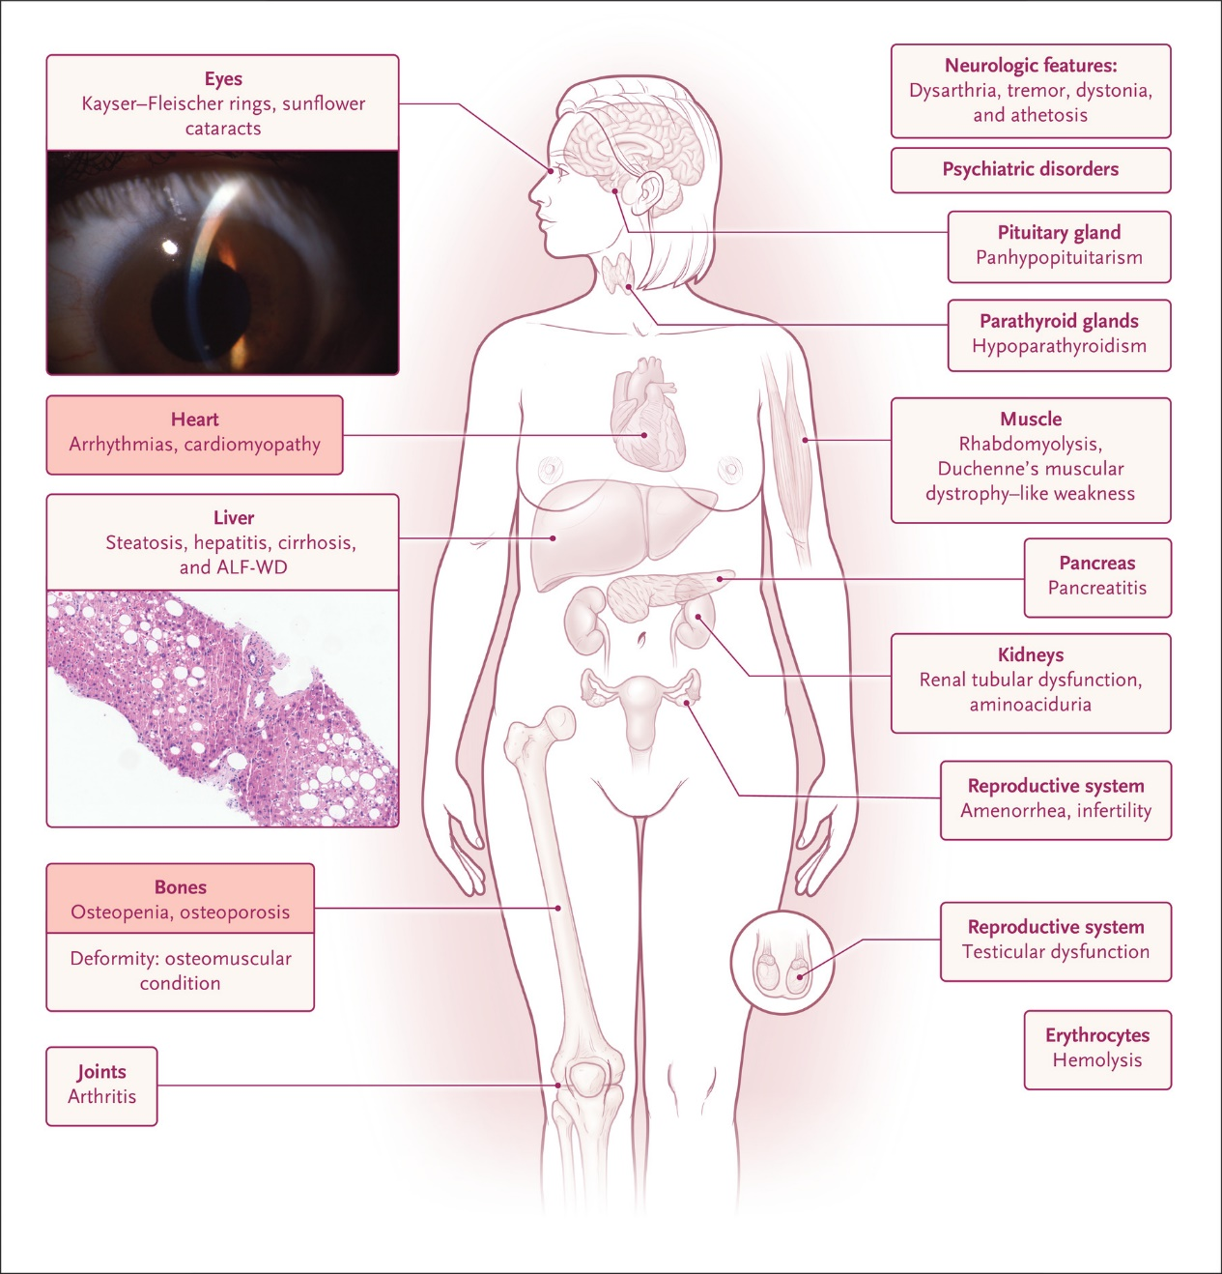
Multidisciplinary approach
Roberts EA, Schilsky ML. Current and. N Engl J Med 2023.
Notes:
Wilson disease is a wide spectrum disease. This is not only a story about liver and neurology. We should advocate for multidisciplinary management.

Slide 47
What about our patient !?
VZV IgM -, VZV IgG +
Acute VZV reactivation with hepatitis on a background of NASH

Slide 48
VZV infection: clinical manifestations
Gershon AA et al. Nat Rev Dis Primers. 2015

Slide 49
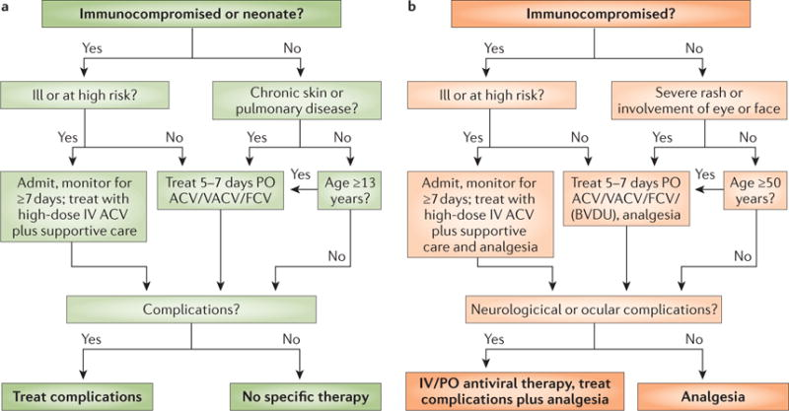
VZV treatment
Gershon AA et al. Nat Rev Dis Primers. 2015

Slide 50
Chronic Liver Function Test Elevation
Laboratory Tests
Initial
Follow-up
HBsAg, anti-HBc, anti-HBs (and anti-HAV); anti-HCV
Ferritin, transferrin saturation
α1-antitrypsin (or serum protein electrophoresis)
Coeruloplasmin
Autoantibodies and IgG (ANA, AMA, SMA)
TSH
Anti-tTG (and IgA)
HBeAg, anti-HBe, HBV DNA, anti-HDV; HCV RNA, HCV genotype
HFE genotyping
α1-antitrypsin geno- or pheno-typing
24-h urinary copper excretion, …
Liver biopsy

