Slide 1
Update on RSV
Journée scientifique Interjurassienne de la Santé
Jeudi 8.06.2017
Sandra A. Asner
Notes:
http://www.sabin.org/sites/sabin.org/files/Janet
%20Englund.pdf
Depuis l’utilisation des outils moléculaires, la majorité des infections PED ont été attribuées aux virus resp. parmi les principaux virus respiratoires détectés, nous retrouvons le VRS, qui sera majoritairement traité aujourd’hui, le rhinovirus RV et les infections à hMPV. Ce talk va être essentiellement focalisé sur RSV et sur les nouveautés de ce virus essentiellement PED

Slide 2
Outline of presentation
1. RSV
2. Treatment and prophylactic options
3. Project presentation
4. Conclusion & implication
Notes:
* Will be separated by patient population

Slide 3
About RSV

Slide 4
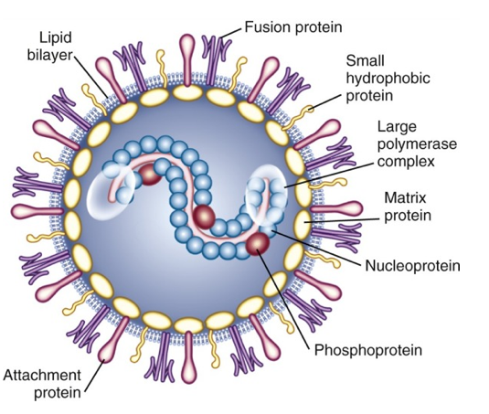
The Virus
Notes:
Paramyxovirus, enveloped virus with 10 viral protein- single RNA stranded
2 antigenic groups A &B

Slide 5
Seasonality of Respiratory Agents
30
25
20
15
10
5
0
RV
Parainfluenza viruses
Percent
30
25
20
15
10
5
0
RSV
Influenza virus
Percent
Jan
Apr
Sep
Oct
Nov
Dec
Jan
Feb
Mar
Apr
May
Jun
Jan
Apr
Sep
Oct
Nov
Dec
Jan
Feb
Mar
Apr
May
Jun
Notes:
The seasonality of infection with various respiratory viruses has been well established by long-term longitudinal studies¹ and short-term studies during the cold season² and confirmed with viral isolation techniques.²
Although RVs are isolated in all months of the year, the peak occurs at the beginning of the school year, presumably because contact among children increases. School attendance is associated with high RV illness rates in the family.¹ Studies using RT-PCR techniques to detect RV RNA have confirmed the fall peak in incidence of RV infection in adults with self-diagnosed colds.²
The autumn peak of RV illness differs from the seasonal peak of influenza virus, which occurs in the winter months (December through early April, depending on the virus type).³
1. Monto AS. Studies of the community and family: acute respiratory illness and infection. Epidemiol Rev. 1994;16:351-373.
2. Arruda E, Pitkäranta A, Witek TJ, Jr, Doyle CA, Hayden FG. Frequency and natural history
of rhinovirus infections in adults during autumn. J Clin Microbiol. 1997;35:2864-2868.
3. Monto AS, Sullivan KM. Acute respiratory illness in the community: frequency of illness and the agents involved. Epidemiol Infect. 1993;110:145-160.

Slide 6
Epidemiology
Reservoir:
  Humans
Transmission:
  Contact and droplet
  Can survive long periods on hands and surfaces
Incubation Period:
  2-8 days (4 to 6 most common)
Notes:
Direct contact is the most common
Large aerosol droplets also implicated
Survive up to 30 minutes hands, 30 hours on hard surfaces
Easily killed with standard cleaning agents

Slide 7
Epidemiology
Period of communicability:
  Viral shedding 3 – 8 days
  Longer in immunocompromised (4 wks)
Attack rates:
  50% family members
    62% those < 1 year
    40% age 1 – 45 years

Slide 8
Epidemiology
Infects 2/3 children in 1st year of life
Almost all children infected by 2 years of age
  Most important cause of bronchiolitis in infants and young children
Reinfection common
  Usually upper respiratory tract
  Severe disease in at risk populations
Notes:
20-30% infants LRTI, 3% hospitalized…. Mortality is 10 x that of influenza

Slide 9
Risk factors for severe disease
Age (infancy/elderly)
- With or w/o high risk conditions
Immunocompromised
- Type & timing of transplant, degree of immunosuppression
- BMT: GVHD, T cell depletion Lymphopenia (<100), HLA mismatch, nosocomial
CLD, CHD or prematurity
Nosocomial infection
Mortality with RSV bronchiolitis and/or pneumonia:
3-5 % vs 0.5%
Notes:
Severity rather related to host factors than to circulating strains
(Protective IS: secretory and serum antibodies and MHC class I-restricted cytotoxic T lymphocytes (TH1-CTLs))
Seasonal occurrence of RSV: predictable severity varies and is more correlated to host factors rather than circulating strains

Slide 10
Burden of RSV-related infections in immunocompromised subjects
RSV-> significant morbidity and mortality among immunocompromised subjects, ++++ HSCT
50% patients with leukaemia/HSCT-> progression URT-> LRT*
Rates of progression 0-60% (mean 38%)- not universal
Mortality rates 20-80%
Progression URTI->LRTI: lymphopenia, allo-HSCT, GVHD, diagnosis within 1 mo of transplantation
(preengraftment phase > 30 days)
Treatment options limited and controversial for treatment of
established pneumonia
-> Preemptive strategies
Khanna et al, Clin Infect Dis 2008
Notes:
Infants 90%, older children 70%, progression to LRTI 0.5
Frequency of progression URTI-*> may be associated with lymphopenia, all-BMT, GVHD, and diagnosis within 1 mo of TX

Slide 11
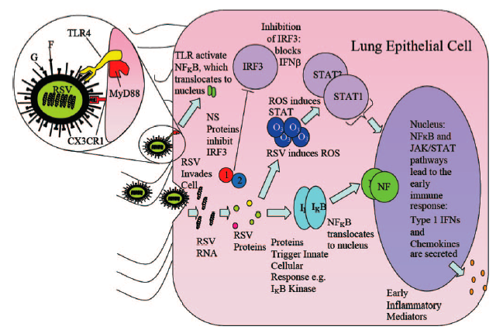
Pathogenesis
Notes:
RSV binds via F protein to TLR4, G protein also binds and helps with fusion and entry into the lung epithelial cell. Triggers iune reponse

Slide 12
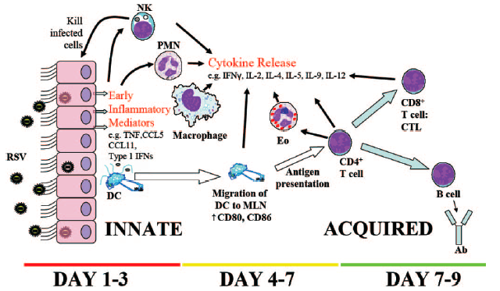
Pathogenesis
Notes:
Cells involved in the immune response to RSV… cellular infection triggers release of early inflammatory mediators TNF
Dendritic cells carry viral antigen to lymph nodes and present to CD4 cells
IFN type 1 source majeure d’attraction des monocytes au site ET

Slide 13
Diagnosis
Direct Fluorescent Antibody (DFA)
(sensitivity: 93.5%, specificity: 99.6%)
DFA negative ➔ Shell Vial Culture
(sensitivity 57-90% vs IFA)
PCR
Commercial assays: e.g ResPlex II assay (Qiagen), Seeplex RV assay (Seegene Inc., Seoul, South Korea)..
(sensitivity of 100%, specificity 98.4% and 97.4% for RSV A and RSV B)
Home based-multiplex PCR (CHUV, 14 viruses)
(sensitivity & specificity of 100% for RSV A and B)
GenExpert- rapid testing since winter 2014-15
Notes:
Shell vial culture – (48 hour results) sensitivity 93% and specificity 97%
Multiplex PCR – higher sensitivity and specificity developed to address the poor sensitivity of conventional tests-
= most sensitive method for detecting RSV, followed by cultureand EIA

Slide 14
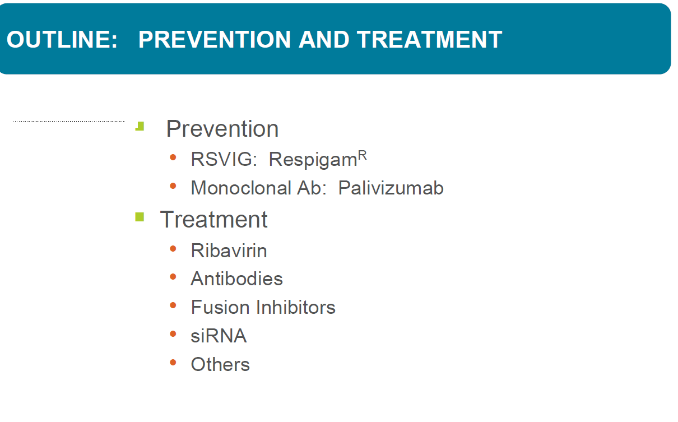

Slide 15
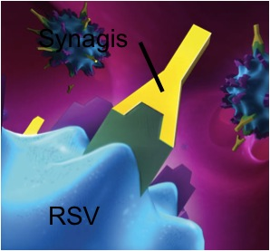
Prevention
RSV-IVIG (Respigam)- Hyperimmune RSV-IVIG, 1996-MedImmune, Inc
Humanized monoclonal F-specific antibody, Palivizumab (Synagis), 15 mg/kg/dose
Humanized monoclonal antibody
Not blood derived
Binds the F protein of RSV-> blocks the fusion of infected cells
Reduced viral activity and cell-to-cell transmission of RSV
Notes:
IVIG: polyclonal, blood derived, cyanotic spells in cardiacs, failed to show efficacy usually used in combination with other molecules
Palivizumab: Humanized monoclonal antibody, Not blood derived
Binds the F protein of RSV-> blocks the fusion of infected cells
Reduced viral activity and cell-to-cell transmission of RSV
Approved for prophylaxis ( 5 doses) BUT Preemptive strategy (1 dose) -> limited information*
-> High-risk patients ‘NACI (National advisory committee on immunization) guidelines children < 2yo with BPD requiring o2 within 6 mo of RSV season, infants born <32 wks who are < 6 mo of age at start of RSV, HR 33-35 weekers, children < with hemodically significant heart disease
-> Immunocompromised patients “Consensus”
Recent SOT, allogeneic BMT (<2-5yo), immunocompromised subject on replacement immunoglobulin (lack of strong evidence about efficacy and high cost but helped control of nosocomial RSV
Preemptive strategy (1 dose)
-> limited information*
Studies used RIB, +/- IVIG or palivizumab: limited by small sample sizes->limited to inpatients, retrospcective design, proof of efficacy from RCT is lacking. Last rCT focus on inpatient and very strict inclusion criteria
One RCT enrolled 14 patients over 5 yrs (3 sites): logistics to conduct appropriate blinding(daily assessment by investigator blinded to treatment assignment for progression to pneumonia, inpatients
Outcomes: clinically and RX proven pneumonia and virologically proven pneumonia 4 w postrandomization observation period
Results trend to decreased clinically, RX, micro proven pneumonia

Slide 16

The IMpact-RSV study
Multicentered RCT : 139 centers, 1502 children
Inclusion criteria
≤ 35 WG or < and 6 months of age or younger
≤ 2 yo old with BPD requiring ongoing treatment within the past 6 months
Endpoints
Primary : Reduction of incidence of RSV hospitalization
Secondary (efficacy) endpoints: Total days of admission, days with increased oxygen requirements, days with an LRI score of 3 or greater

Slide 17
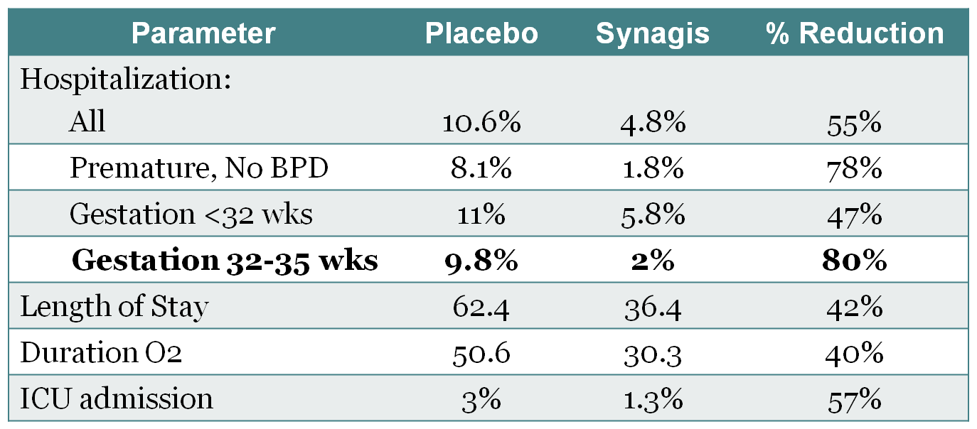
Summary of Impact-RSV study
IMpact-RSV Study Group Palivizumab, a humanized respiratory syncytial virus monoclonal antibody, reduces hospitalization from respiratory syncytial virus infection in high-risk infants. Pediatrics 1998 , 102:531-537.
Notes:
- 55 % (41% in IGIV) reduction in hospitalization
80% reduction in 32-35 weeks vs 47 % in the < 32 weeks
La prophylaxie par Palivizumab a permis de réduire de 55% le taux d’hospitalisation pour RSV. Cette réduction était de 78% pour les enfants prématurés sans dysplasie bronchopulmonaire et de 39% pour les enfants avec dysplasie bronchopulmonaire. Il a été noté dans le groupe avec traitement, une diminution des journées d’hospitalisation et d’oxygénodépendance suite à l’infection à RSV, une diminution des journées d’hospitalisation pour maladie des voies aériennes inférieures modérément graves à graves et un taux réduit d’hospitalisation aux soins intensifs.
Secondary endpoints:
Fewer total days of hospitalization, days with increased 02 and days with an LRI score of 3 or greater
Safety: Adverse events reported by similar in both arms

Slide 18
Cardiac synagis study group CSSG
Multicentered RCT : 76 centers, 1287 children
Inclusion criteria
- ≤ 2 yo with hemodynamically significant CHD
- Unoperated or partially corrected CHD
Endpoints
Primary : Reduction of incidence of RSV hospitalization
Secondary: Total days of admission, days with increased 02 requirements, ICU admission and need for mechanical ventilation
Notes:
Similarily to IMPACT_CSSG study

Slide 19
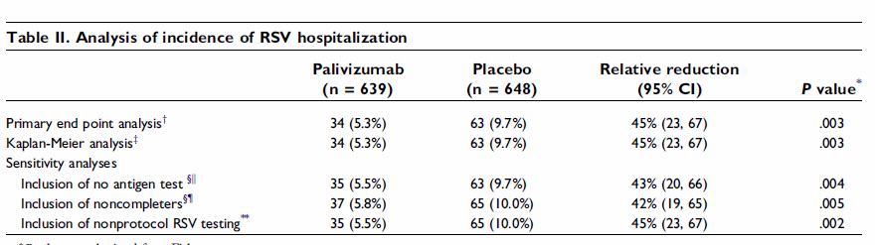
Cardiac synagis study group CSSG
45% reduction in hospitalization
Significant reduction in days of RSV hospitalization and days
with increased oxygen requirement

Slide 20
Who benefits from Palivizumab?
Children < 2 yrs with BPD who require ongoing medical therapy within 6 months RSV season
Children < 2 yrs hemodynamically significant cardiac disease
Infants born at ≤ 35 wks GA who are ≤ 6 months of age at start of RSV season
Notes:
3. Is a newer group as IGIV has been shown initially to be dangereous for this patient-population: increased surgically adverse effects in cynotic heart =cyanotic spells, 2n to hyperviscosity due to IGIV: Are at special risk: cyanotic heart disease, mod or severe PHT, medication for congestive heart failure
Now the category 33-35 represents a challenge
CHD=congenital heart disease

Slide 21
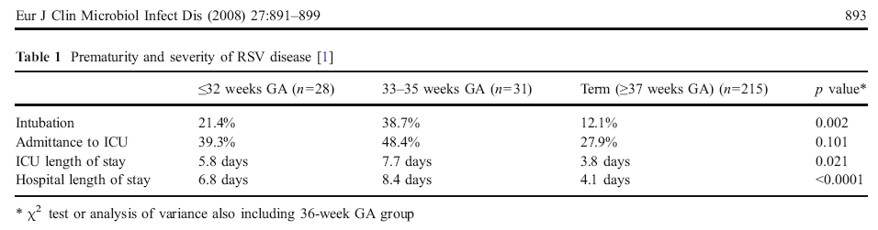
Premature infants 33-35 weeks
- 70% of preterm infants < 36 WGA
- Greater benefit from Palivizumab compared to 32
WG (Impact)
- Risk scoring tool -> cost-effective strategy
Notes:
Seem to absolutley benefit from Palivizumab as a group but less as individuals, given the importance of this patient-population-> Cost-effective strategy (next slide
Risk scoring tool: to identify the risk factors which contribute
the most to RSV-related risk for
Hospitalization

Slide 22
Predictors of RSV Hospitalization at baseline interview
PICNIC study (33-35 WG)
Risk factors | OR | 95% CI | P value
Nov-Dec-Jan birth | 4.88 | 2.57-9.29 | <0.001
Male gender | 1.91 | 1.10-3.31 | 0.02
Small for gestional age | 2.19 | 1.14-4.22 | 0.019
Daycare attendance | 12.32 | 2.56-59.34 | 0.002
Any preschool-age sibling | 2.76 | 1.51-5.03 | 0.001
> 2 smokers at home | 1.71 | 0.97-3.00 | 0.064
> 5 persons at home | 1.69 | 0.93-3.10 | 0.088
Eczema in first degree relative | 0.42 | 0.18-0.996 | 0.049
Law BJ. PIDJ 2004; 23: 808.
Notes:
PICNIC prospective study looking at predictors for RSV admissions.
66 RSV+ and 1600 RSV - admission and looked in univariate analyses and multiple regression model which predictors were associated with their primary outcome: RSV admission
This table shows the final multiple regression model
Limitation: small N of proven RSV positive individuals. Generalizability limited , remote areas, rural settings underrepresented

Slide 23
Risk factors for RSV Hospitalization (33-35 GA) aged 6 months and less, admitted with proven RSV LRTI
FILIP study: Cases: 186; Controls 371
Variables | OR | 95 % CI
Absolute chronologic age at start of RSV season </=10 wks | 3.95 | 2.65-5.90
Breast-feeding < /=2 months | 3.26 | 1.96-5.42
School age siblings (>/=1) | 2.85 | 1.88-4.33
N residents and/or vitors at home >/=4 | 1.91 | 1.19-3.07
History of wheezing in the famlily | 1.90 | 1.19-3.01
Cummulative effect:
2 risk factors: increase for RSV admission btw 3.62 -12.87
Notes:
Cases all premies 33-35 d/c during the infectious RSV season aged 6 mo and <: admitted with a proven RSV lower infection
Controls all premies born at or directly transferred to a given participating Hx within the same time period matched to cases with GA and transferred to HX within same period

Slide 24
33-35 weeker w/o CLD < 6 months of age at start of RSV season and
≥ 2 following risk factors
- Daycare
- School-aged siblings
- Passive smoke exposure
- Airway abnormalities or neuromuscular disease
→ Palivizumab prophylaxis

Slide 25
Who benefits from Palivizumab?
1. Children < 2 yo with BPD requiring medical therapy
2. Infants born at ≤ 31 wks
3. Children < 2 yo with hemodynamically significant heart disease
4. Children with airway abnormalities or neuromuscular disease
5. 32-34 6/7 wks infants + at least one RF and born 3 months before or during RSV season (maximum of 3 doses)
6. Other ----
? Immunocompromised, ‘’Consensus’’
Recent SOT, allogeneic BMT (<2-5yo), immunocompromised subject on replacement immunoglobulin ->helped control of nosocomial RSV
Bueno S, Pediatr Infect Dis J 2007;26:1089-93
  Chakrabarti S, Bone Marrow Transplant 2001;28:759-63.
  Boeckh M, Clin Infect Dis 2007;44:245-9
  Kassis C, Biol Blood Marrow Transplant 2010

Slide 26
Critères CH, Paediatrica 2004
Anciens prématurés avec DBP sévère voire DBP modérée (âge <de 12 mois au début de la saison VRS) -> risque d’hospitalisation très élevé
Enfants avec une malformation cardiaque congénitale hémodynamiquement significative voire <12 mois au début de la saison RSV avec facteurs de risques individuels:
Cyanose, hypertension pulmonaire sévère et/ou une insuffisance cliniquement manifeste, sans correction chirurgicale possible
Autres facteurs de risque: mucoviscidose, déficits immunitaires, maladies neuromusculaires
-> Le palivizumab n’a pas été enregistré et n’est donc pas remboursé par les assurances maladie.
Notes:
L’administration de routine de palivizumab selon les indications enregistrées auprès de Swissmedic ou retenues comme obligatoirement remboursées par les assurances maladie par l’OFAS n’est pas recommandée. 2) que, en Suisse, le décours de l’hospitalisation due au VRS d’anciens pré- maturés sans facteurs de risque supplémentaires ne diffère pas de façon substantielle de celui de non-prématurés, (3) que l’administration de palivizumab n’est pas économique.

Slide 27
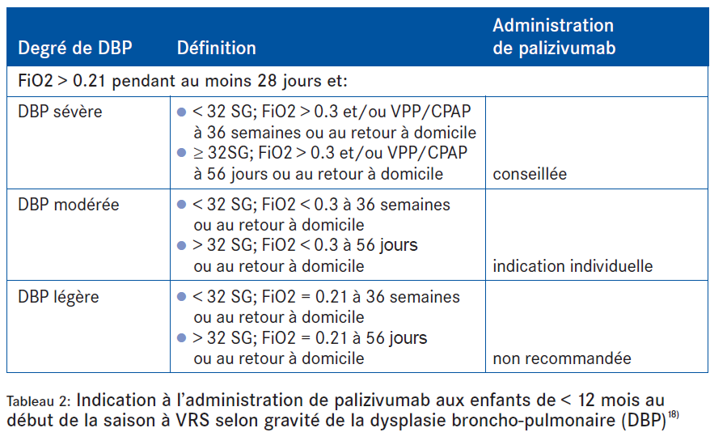
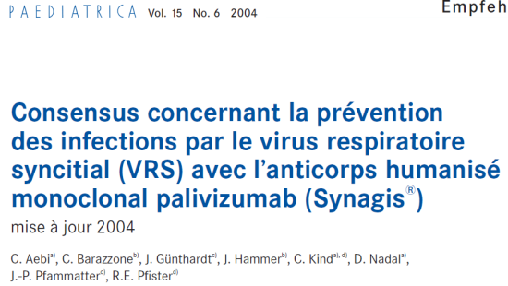

Slide 28
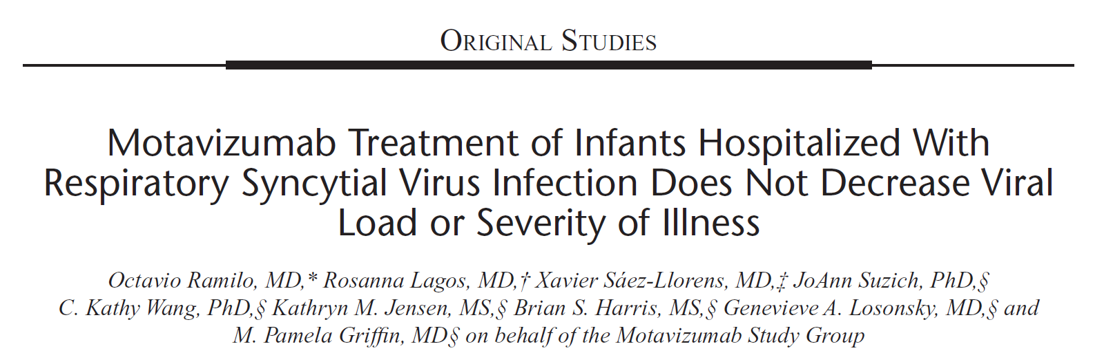
Motavizumab- > (NumaxTM)– higher potency F-specific monoclonal antibody; not licensed in 2010 after FDA review of clinical studies in at-risk infants
Notes:
RCT 3 arm- placebo controlled 30 mg/kg, 100 mg/kg vs placebo (30 perarm) > 36 WG who were <12 mo of age at randomization and hospitalized for LRTI with a documented positive RSV test within 48 hrs before randomization study endopints nasal wash samples (viral load)
PRO: LOS, need for supplemental 02and mechnaical ventilation and admissioon to ICUand LOS ICU
->No effect on clinical outocmes nor decreased viral loads in URTI (not powered for clinical outcomes)
we're not looking at a product that has evidence of superiority in terms of efficacy" when compared to the already available monoclonal antibody Palivizumab

Slide 29
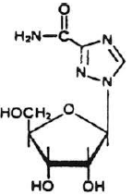
Treatment/preemptive strategies
Ribavarin (aerosolized or oral)
FDA-approved drug for treatment of Pneumonia in HR- children
Licensed for aerosol treatment of RSV in children and orally
$50 000 (10-day course of A-R)
RIB +/- immunomodulators vs no treatment
Shah et al, Blood 2011 (SR), Shah DP et al, J Antimicrob Chemother 2013
prevention of progression URTI->LRTI (45%-16%)
mortality in adult HSCT vs no therapy (70%-35%)
RIB iv =po efficacity in preventing RSV LRTI in 10 adults HSCT recipients with severe lymphopenia
Gueller S et al, Trasnpl Infect Dis, 2013
No benefit of A-RIB for preventing progression to LRTI
Kim YJ et al, JID, 2014
Notes:
RIB (broad spectrum nucleotide analogue gainst DNA and RNA viruses): only FDA approved drug for tt pneumonia in high risk children but limited by its cost, potential side effects for health care workers, hosp to get delivered
Shah et al: plus grandre cohorte retrospective d’allo-BMT (env 300 pts): single and most protective factor of progression to LRTI and death
Despite its potential benefits: treatment with RIB not routinely recommended: inconvinient administration, high cost, questionable efficacy, lack of RCTR-> decision in AV therapy remains controversial- avec RCT challengoing given high morbidity and mortality râtes in this patient population thus emphasizing the need to identify target patient population- increase cost-effectiveness of RIB based therapxy

Slide 30
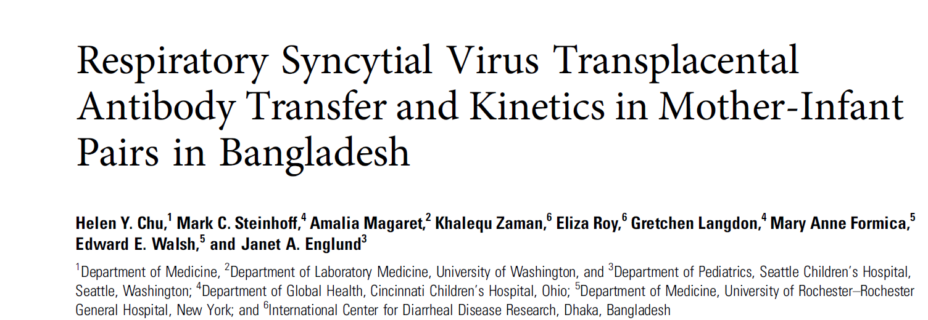
RSV fusion protein-based vaccine (Novavax )- not immunogenic but safe with efficient transplacental Ab transfer; phase I RCT
Tested RSV-neutralizing Ab-> third trimester, birth, 72 weeks of age
Results: maternal Ab titers stable from 3rd trimester->birth, half life of Ab in
infants-> approximately 1 month
-> RSV vaccination in 3rd trimester=effective in providing RSV neutralizing Ab to infants in the first months of life
Notes:
RCT of maternal immunization with influenza or pneumococcal vaccines in Bangladesh
Residual sera from all time points were available from a subset of 149 mother-infant pairs who had completed follow-up to the end of the 72-week period from that RCT. These samples were tested for RSV-neutralizing Ab. Sociodemo- graphic and clinical information were collected as part of the parent study. Small-for-gestational-age (SGA) was defined ac- cording to US birthweight data [26].
These findings suggest that maternal RSV vaccination during the third trimester may be an effective method to provide RSV-neu- tralizing Ab to infants in the first months of life.
RSV is generally assumed to cause a self-limited upper respi- ratory tract infection in healthy adults. In response to natural infection, as opposed to vaccination during clinical trials, both young adults and elderly individuals have been shown to mount a 4-fold increase in Ab levels [31].

Slide 31
Other
Small-interfering RNA’s (si-RNA)
Short lengths of double-stranded RNA->directed against mRNA RSV nucleocapsid protein that regulates gene expression
RSV-specific siRNAs [ALN-RSV01 (siRNA), Alnylam Pharmaceuticals, Cambridge, MA] - 2 RCT
Targets two nucleocapsid protein genes, the P protein and N protein genes
Two phase II trials completed
Prophylaxis prior RSV inoculation in healthy volunteers -> 38% decrease in N of infections
Zamora et al, Am J Respir Crit Care Med, 2011:
Lung transplant with confirmed RSV infection-> reduction of daily scores and bronchiolitis obliterans
DeVincenzo J et al, Proc Natl Acad Sci USA, 2010
Notes:
Directed agaiknst mRNA of RSV nucleoscapsid protein, 2 RCT: 1) prophylaxis prior RSV inoculation healthy adults, 38% decrease in N of infections; 2) Lung TX -> reduction in daily sy scores & bronchiolitis obliterans

Slide 32
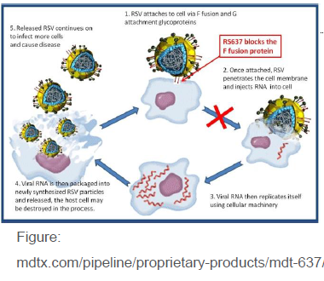
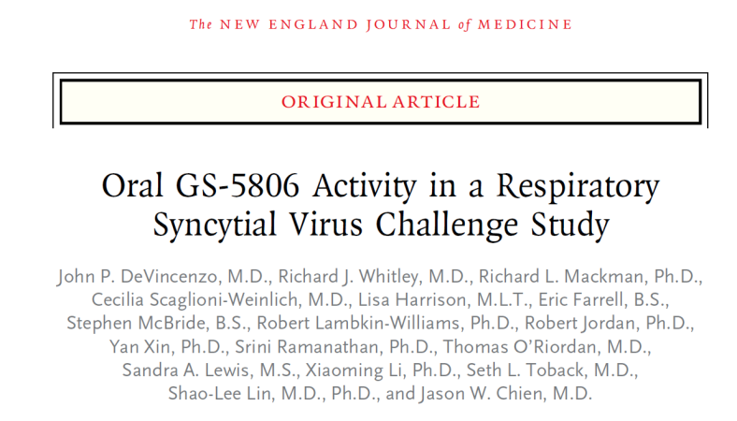
Fusion inhibitors: Most common Antiviral Target
Notes:
Importance of dusion in rSV disease well studied
Conservation of F protein and function among RSV well documented
Treatment with GS-5806 reduced the viral load and the severity of clinical disease in a challenge study of healthy 54 adults. (Funded by Gilead Sciences; ClinicalTrials.gov number, NCT01756482.).
We conducted a double-blind, placebo-controlled study of GS-5806, an oral RSV-entry inhibitor, in healthy adults who received a clinical challenge strain of RSV intranasally.

Slide 33
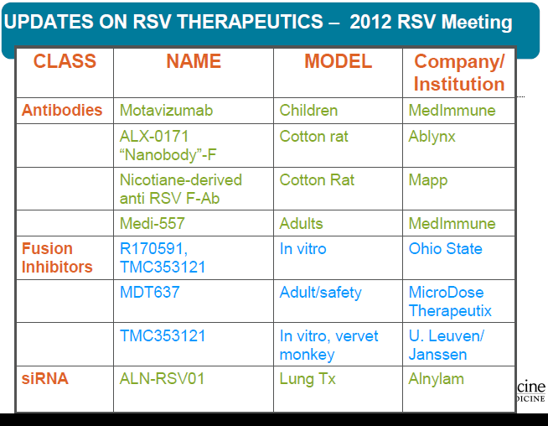

Slide 34
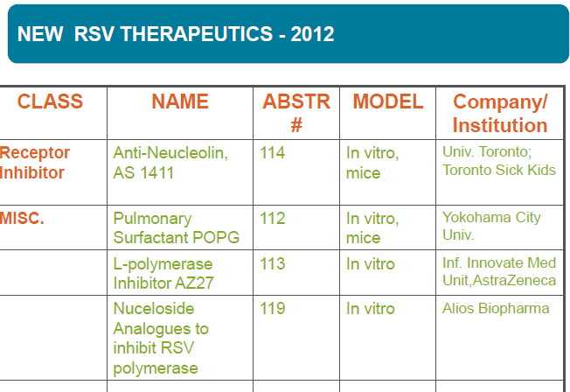
Notes:
Bcxp de traitement en phase investigat

Slide 35
Rationale for severity score tools
Treatment with RIB not routinely recommended: inconvenient administration, high cost, questionable efficacy, lack of RCT
RSV antiviral therapy remains an important unmet medical need-> numerous molecules ongoing Phase I/II trials
RCT challenging given high morbidity and mortality rates in this patient population-> need to identify target patient population
-> need to identify patients most at risk

Slide 36
Who benefits from Palivizumab-> which patient-population has been studied
Which patient-population has been identified more recently
Which patient-population has not been looked at….

Slide 37
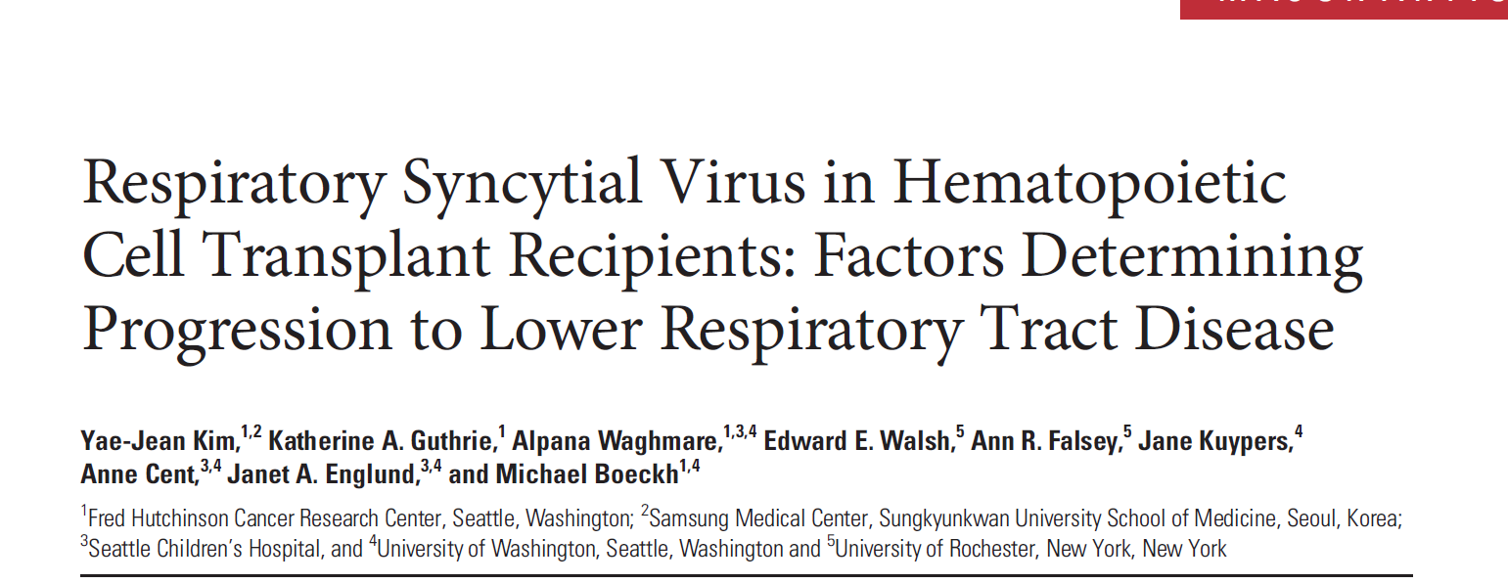

Slide 38
Aim
To determine significance of host, viral, treatment factors for the progression to RSV LRI (cumulative incidence)
Retrospective cohort of 150 allo-HSCT and 34 auto-HSCT

Slide 39
Predictors for progression
age, sex, smoking,
donor type, cell source, donor & recipient serostatus, year Tx
TBI a/cGVHD
ALC at time RSV-URI
PreTx lung function
RSV subtype
Time TX to RSV infection
RIB, steroid , antibody levels and weekly IVIG infusion

Slide 40
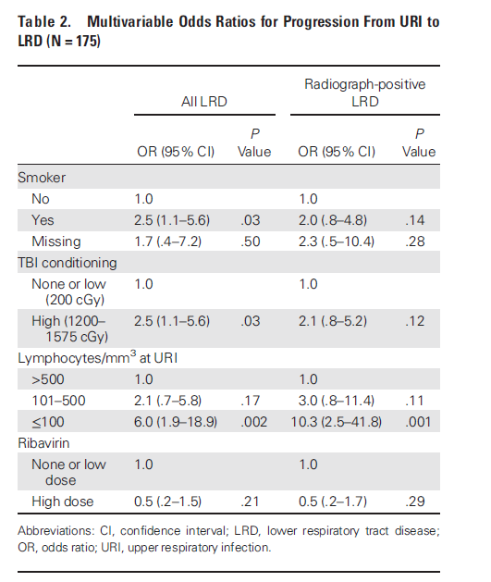
Results
138/181 (76%) URTI only, non progressors
43/181 (24%) progressors to LRTI
Notes:
Further stratified analysis btw treatment effect in the low lymphocyte strata-> stronger trend in the low lymphocyte group, which did not reach significance (total ALC<300 vs >300)

Slide 41
Conclusions
Significant risk factors for progression:
Smoking, Conditioning TBI (1200-1575 cGy) and
ALC <100/mm3
ALC>1000/mm3: completely progressive against RSV disease progression
-> importance of ALC and lack of importance of Abx levels-> better knowledge of RSV-specific cell mediated immunity

Slide 42
Rationale
Data on the burden and risk factors associated with severe RSV disease among immunocompromised patients in Switzerland are limited.
Lack of tools addressing risk factors for severe RSV disease amongst other immunocompromised patients & children
SOT, Leukaemia/lymphoma, solid tumor
patients requiring chronic immunosuppression
Congenital immunodeficiencies

Slide 43
MAIN STUDY OBJECTIVES
1) To determine the number of severe RSV-related respiratory illnesses defined as RSV-related hospital admission ,LRTI &pneumonia among children and adults with an underlying immunosuppression hospitalized with RSV infection.
2) To identify clinical and demographic risk factors for severe RSV disease.
Notes:
Important state that this is pilot with important feasibility aspects. If pilot feasible-> main study

Slide 44
OVERVIEW
Retrospective cohort study of RSV-related respiratory conditions among immunocompromised patients hospitalized with RSV infection
2 tertiary care centers: CHUV-HUG, over a period of 10 years.
Severe RSV-attributed respiratory condition
- RSV related admission
- LRTI, pneumonia
Multivariable logistic regression ->potential association between predictors and severe RSV-attributed respiratory disease

Slide 45
ELIGIBILITY CRITERIA
INCLUSION CRITERIA
EXCLUSION CRITERIA
Immunocompromised subjects ≥ 1 month: HSCT, SOT , leukaemia, solid tumors, patients on chronic immunosuppressive regimen, congenital or acquired immunodeficiencies
ARI & RSV positive swab
Children < 1 month
Underlying condition qualifying for Palivizumab (NACI)
Negative midturbinate swab or other virus identified or viral co-infections
Pregnancy
HIV infected patients

Slide 46
OUTCOMES
PRIMARY OUTCOME
RSV related admission to hospital
SECONDARY OUTCOME
LRTI
Pneumonia
Notes:
Predictors: Type IS, ALC, ANC, viral loads, RSV A vs B, micro-arrays

Slide 47
Dataset
University Hospital, Lausanne & Geneva
Dataset from the microbiology Laboratory
Since 2005- 8000 respiratory samples
          630 RSV-positive
          239 immunomcompromised adults and children

Slide 48
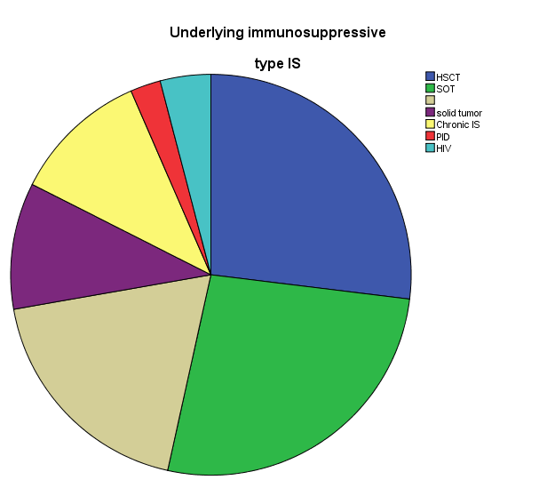
Leukemia/lymphoma

Slide 49
Baseline Characteristics of Immunocompromised Patients with RSV Infection
Variable; number (%) unless indicated otherwise | Children (N=64) | Adults (N=175) | Total (N=239)
Age (pediatric)
<2 years | 13 (20.3)
2-5 years | 21 (32.8)
5-18 years | 30 (46.9)
Age (years), median (IQR) | 4.9 (3.2-7.7) | 56.5 (42.1-64.4)
Male | 35 (54.7) | 87 (49.7) | 122 (51.0)
Type of immunosuppression
HSCT | 8 (12.5) | 59 (33.7) | 67 (28.0)
Autologous | 0 | 10 (16.9) | 10 (14.9)
Allogenic | 8 (100) | 49 (83.1) | 57 (85.1)
SOT | 5 (7.8) | 58 (33.1) | 63 (26.4)
Leukemia/lymphoma | 29 (45.3) | 21 (12.0) | 50 (20.9)
Solid tumor | 11 (17.2) | 16 (9.1) | 27 (11.3)
Chronic immunosuppression | 6 (9.4) | 20 (11.4) | 26 (10.9)
PID | 5 (7.8) | 1 (0.6) | 6 (2.5)
GVHD among allogeneic HSCT recipients | 5 (62.5) | 30 (61.2) | 35 (61.4)
Bacterial co-infection | 9 (14.1) | 27 (15.4) | 36 (15.1)
Viral co-infection | 18 (28.1) | 34 (19.4) | 52 (21.8)
ALC, median (IQR) | 1.0 (0.3-2.1) | 0.8 (0.3-1.5) | 0.8 (0.3-1.6)
Oral ribavirin treatment | 2 (3.1) | 36 (20.6) | 38 (15.9)
Palivizumab treatment | 2 (3.1) | 8 (4.6) | 10 (4.2)
Notes:
HUG- 1.1.2005-31.12.2014: 1373 positive tests for RSV: 1277 patients, 1292 infectious events->184 patients
CHUV- 4.1.2005-23.04.2014: 294 positive tests for RSV 63 IC patients with RSV ->62 patients

Slide 50
Clinical Outcomes of Immunocompromised Patients with RSV Infection

Slide 51
Predictors for RSV-attributable hospital admission among all immunocompromised patients and stratified by age-groups (adults vs children)
N=215 (152 adults, 63 children)* |  | Multivariable analyses
 |  | OR | 95 % C.I | P value
Increasing age (by 10Y range) | All | 1.0 | 0.9;1.2 | 0.558
 | Adults | 1.4 | 1.0;1.8 | 0.027
Bacterial co-infection | All | 1.5 | 0.7;3.3 | 0.340
 | Adults | 1.7 | 0.6;4.5 | 0.286
 | Children | 1.0 | 0.2;4.6 | 0.995
nALC | All | 1.0 | 1.0;1.2 | 0.420
 | Adults | 1.0 | 1.0;1.2 | 0.436
 | Children | 0.8 | 0.5;1.2 | 0.309
Type immunosuppression (Reference: HSCT)
SOT | All | 1.9 | 0.8;4.6 | 0.166
 | Adults | 1.6 | 0.6;4.4 | 0.312
 | Children
Leukemia/lymphoma | All | 3.9 | 1.7;9.7 | 0.002
 | Adults | 1.5 | 0.4;5.2 | 0.556
 | Children
Solid tumor | All | 7.4 | 2.7;21.9 | <0.001
 | Adults | 5.2 | 1.4;20.9 | 0.015
 | Children
Chronic immunosuppressive medication | All | 9.5 | 3.3;30.2 | <0.001
 | Adults | 4.1 | 1.1;16.0 | 0.034
 | Children
PID | All | 4.5 | 0.7;29.0 | 0.097

Slide 52
Predictors of progression pneumonia among all immunocompromised patients and stratified by age-groups (adults vs children)
Outcome: Pneumonia N= 215 (152 adults, 63 children)* |  | Multivariable analyses
 |  | OR | 95 % C.I | P value
Increasing age (by 10Y range) | All | 1.2 | 1.1;1.4 | 0.003
Bacterial co-infection | All | 3.6 | 1.6;8.4 | 0.002
nALC | All | 1.0 | 1.0;1.1 | 0.439
Type immunosuppression (compared to HSCT)
SOT | All | 0.5 | 0.2;1.1 | 0.094
Leukemia/lymphoma | All | 1.0 | 0.4;2.5 | 0.956
Solid tumor | All | 1.3 | 0.4;3.6 | 0.639
Chronic immunosuppressive medication | All | 1.4 | 0.5;3.8 | 0.540
PID | All | 0.7 | 0.0;5.0 | 0.721

Slide 53
Conclusions from our study
Evidence of burden of RSV disease among immunocompromised adults
Severe RSV infections among patients requiring chronic immunosuppression for various rheumatological conditions and those with solid tumors or leukemia/lymphoma.
Scoring systems to identify patients most at risk

Slide 54
Conclusions
RSV preventive strategies do need to be improved
While numerous preventive strategies tested-> still in phase II-III studies
Better delineate children most at risk, immunosuppression, CF, chronic pneumopathies
Increased cost-effective strategies

